Slide 1

Market and Economic Update
A Closer Look at Q4 2023 Data
Released January 2024

Slide 2
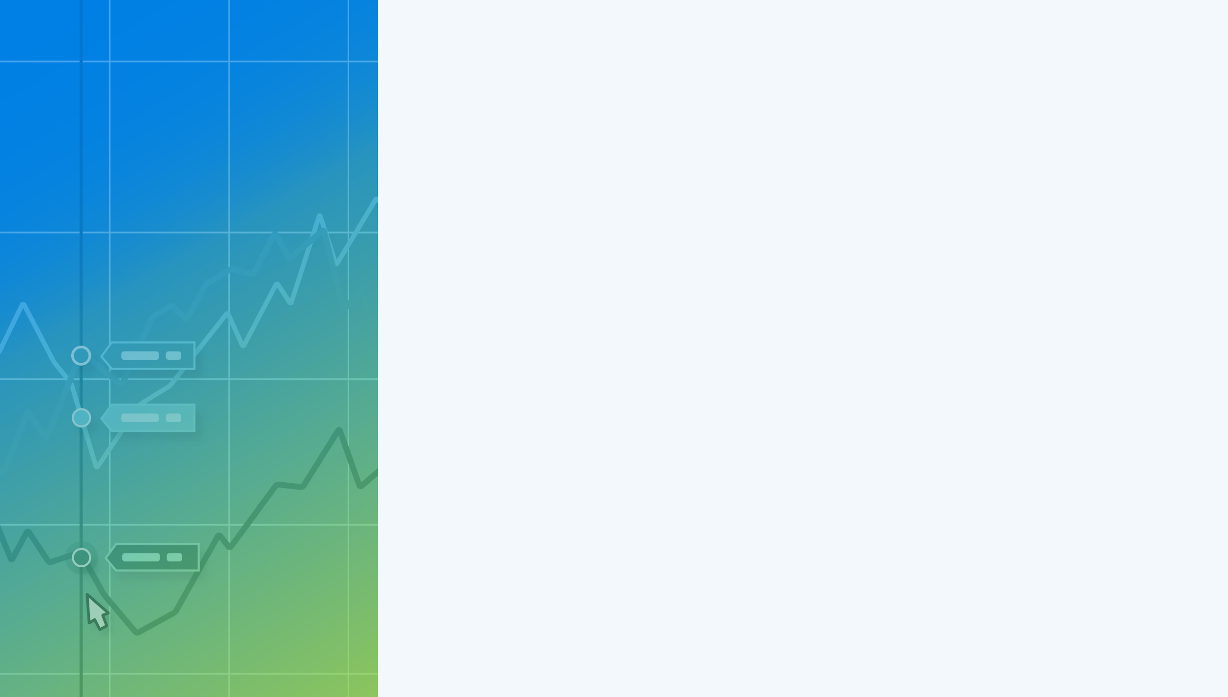
Table of Contents
Market Data
Charts and Tables Highlighting the Performance of Stock Market Indicators and Asset Classes over the Latest Quarter
Macroeconomic Data
Leading and Lagging Economic Data and Trends from Key Economic Reports Published Recently
Bonds & Interest Rates
Collection of Data Summarizing Moves in the Fixed Income Markets over the Last Quarter
Charts of the Moment
Visuals Depicting Trends that are Impacting the Markets
and Investments
Notes:
→ Don’t forget to expand and leverage the commentary provided in the speaker notes section for more details on each slide!

Slide 3
Market Data
Charts and Tables Highlighting the Performance of Stock Market Indicators and Asset Classes over the Latest Quarter

Slide 4
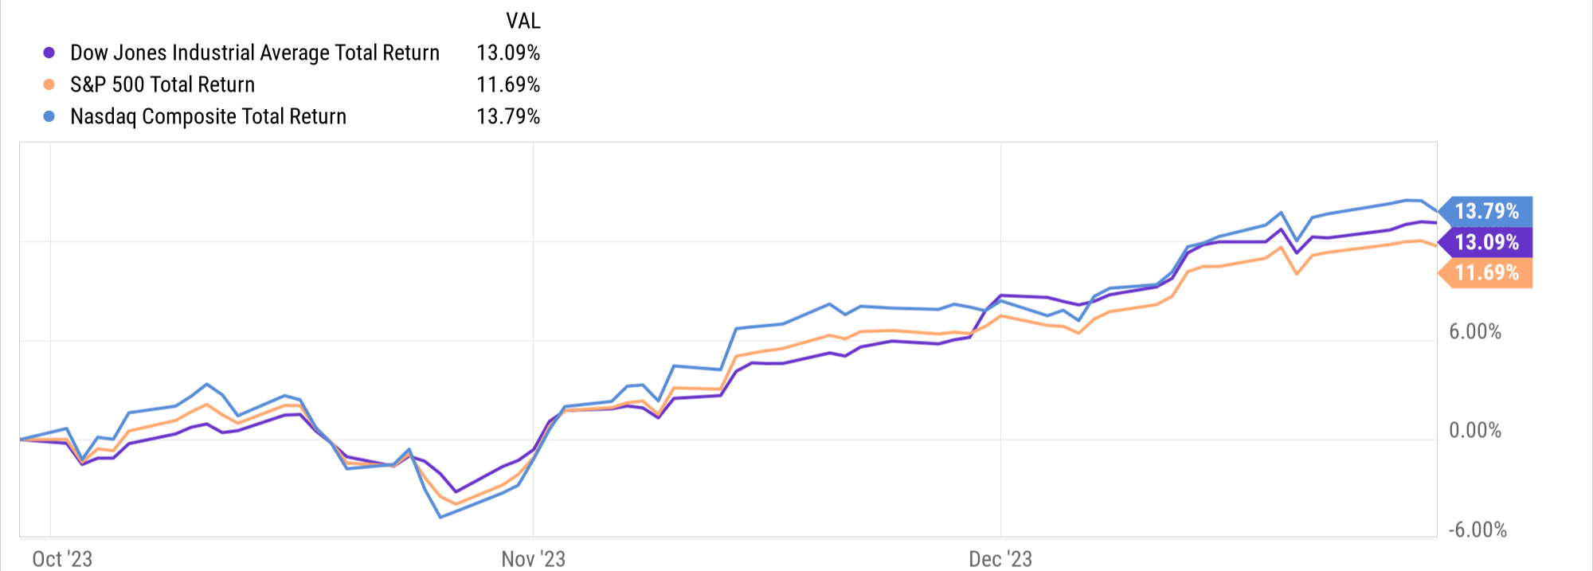

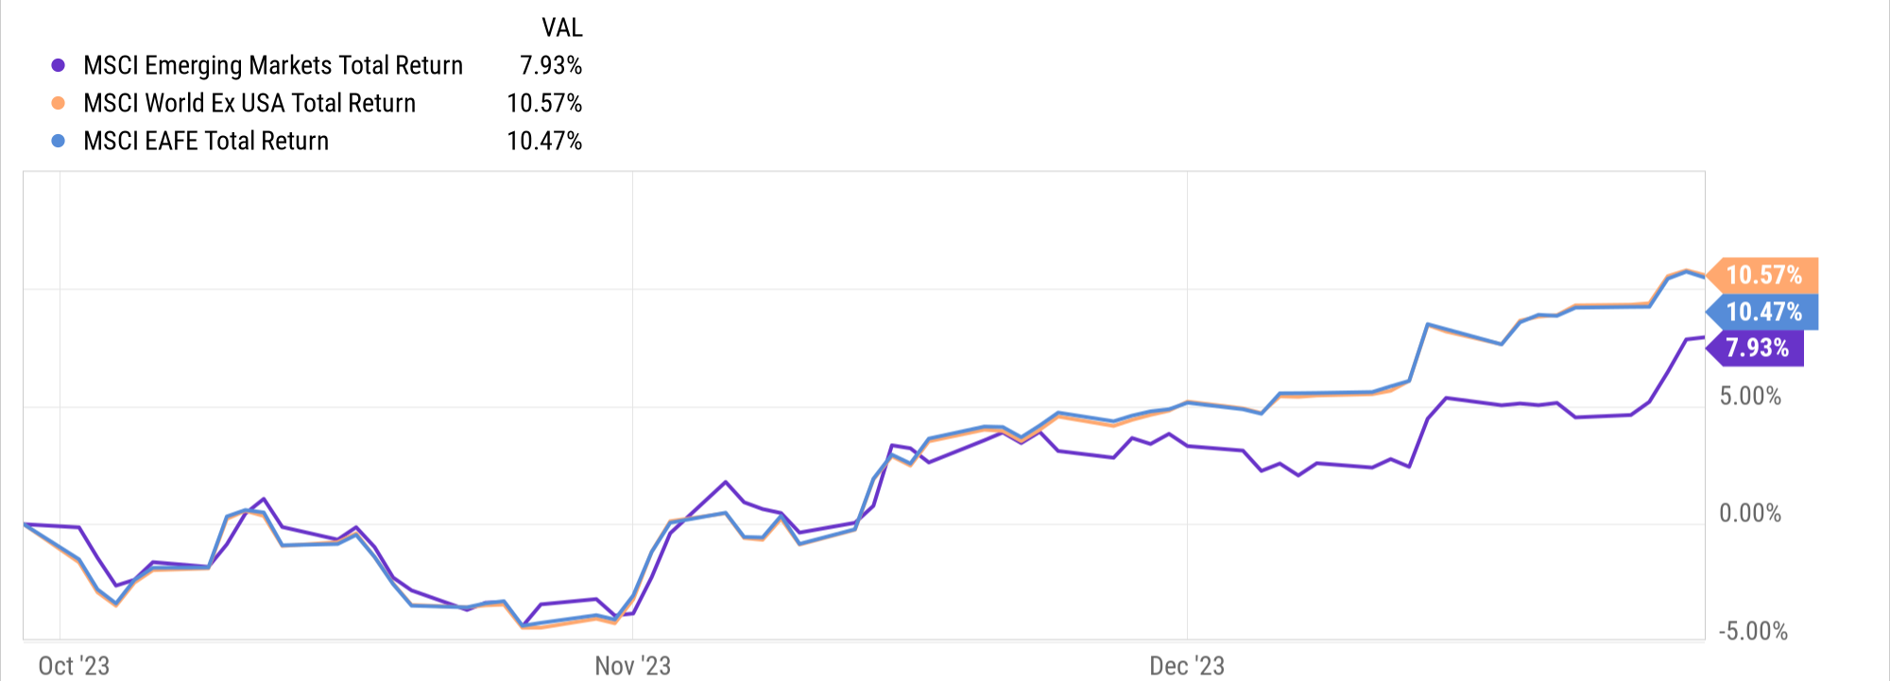
Key Stock Market Index Performance
US Markets | Q4 2023 Return
Dow Jones Industrial Average Total Return | 13.09%
S&P 500 Total Return | 11.69%
Nasdaq Composite Total Return | 13.79%
Global Markets | Q4 2023 Return
MSCI Emerging Markets Total Return | 7.93%
MSCI World Ex USA Total Return | 10.51%
MSCI EAFE Total Return | 10.47%
Notes:
Index Total Returns for Q4 2023:
US Indices:
Dow Jones Industrial Average Total Return: +13.09%
S&P 500 Total Return: +11.69%
Nasdaq Composite Total Return: +13.79%
Global Indices:
MSCI Emerging Markets Total Return: +7.93%
MSCI World Ex USA Total Return: +10.51%
MSCI EAFE Total Return: +10.47%

Slide 5
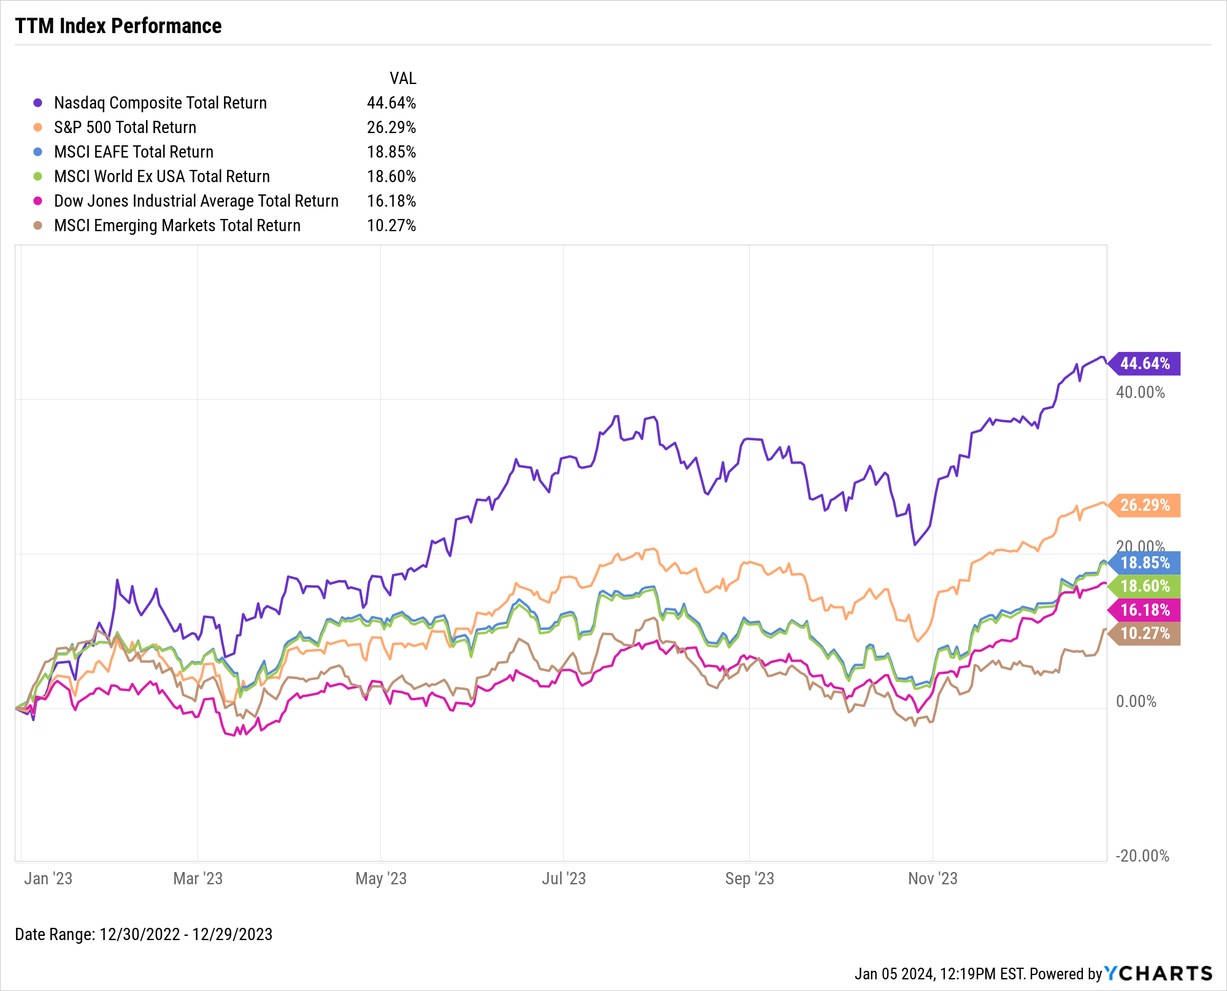
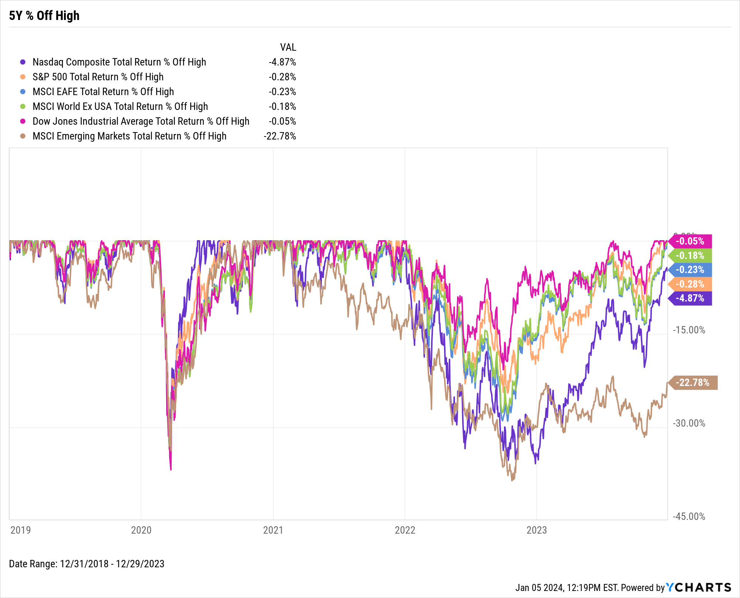
Key Stock Market Index Performance (cont’d)
Notes:
L: TTM Index Returns, 12/31/2022 – 12/31/2023:
Nasdaq Composite Total Return: +44.64%
S&P 500 Total Return: +26.29%
MSCI EAFE Total Return: +18.85%
MSCI World Ex USA Total Return: +18.60%
Dow Jones Industrial Average Total Return: +16.18%
MSCI Emerging Markets Total Return: +10.27%
R: With the exception of MSCI Emerging Markets, all five indices are within 5% of their all-time highs.

Slide 6
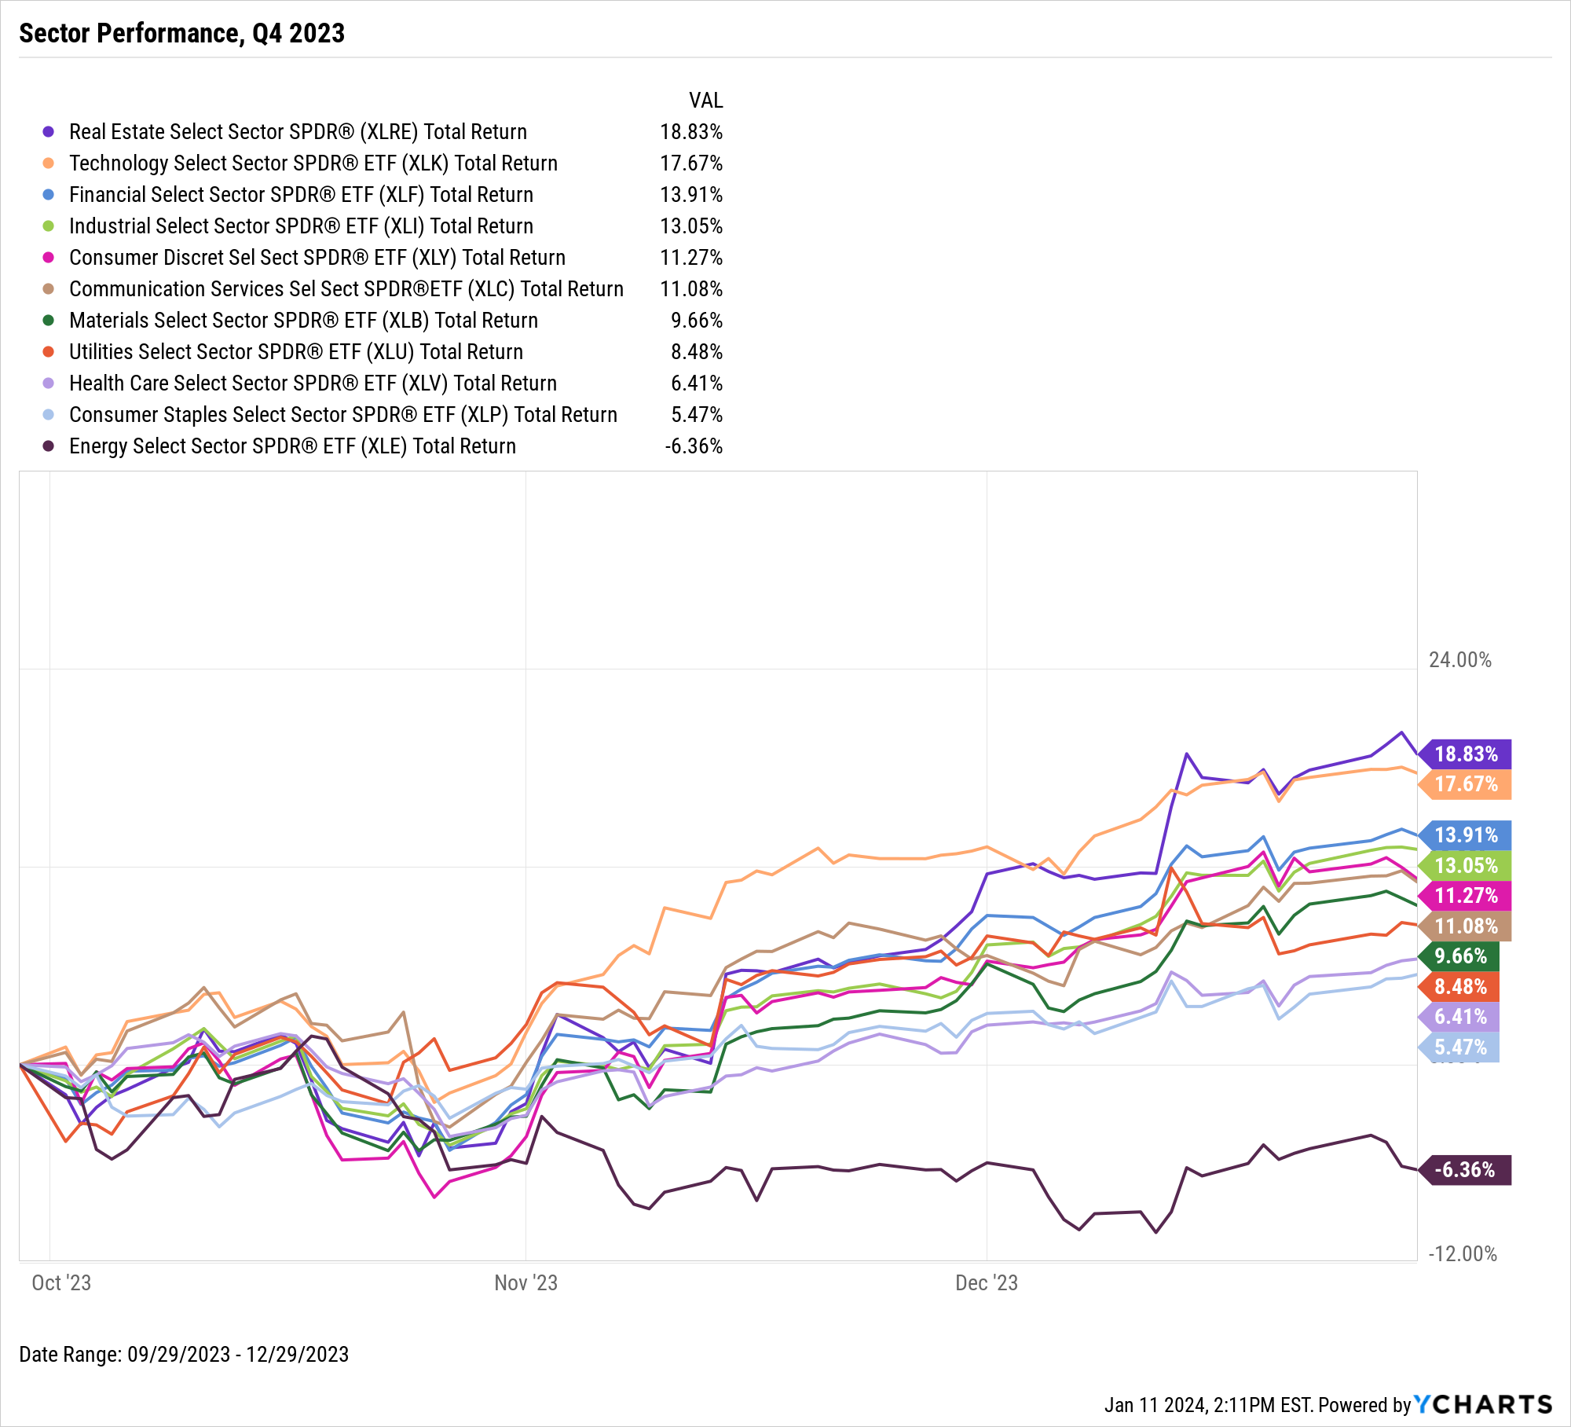
US Stock Sector Performance
Sensitive Sectors | Q4 2023 Return
Energy Select Sector SPDR® ETF | -6.36%
Communication Services Select Sector SPDR® ETF | 11.08%
Industrial Select Sector SPDR® ETF | 13.05%
Technology Select SPDR® ETF | 17.67%
Defensive Sectors | Q4 2023 Return
Health Care Select Sector SPDR® ETF | 6.41%
Consumer Staples Select Sector SPDR® ETF | 5.47%
Utilities Select Sector SPDR® ETF | 8.48%
Cyclical Sectors | Q4 2023 Return
Financial Select Sector SPDR® ETF | 13.91%
Materials Select Sector SPDR® ETF | 9.66%
Consumer Discretionary Select SPDR® ETF | 11.27%
Real Estate Select Sector SPDR® ETF | 18.83%
Notes:
Ten of the eleven S&P Sectors posted positive total returns in Q4 of 2023. The Real Estate sector led the way with an 18.8% total return, followed by Technology (17.7%), Financial (13.9%) and Industrial (13.1%).
Only Energy was in the red in Q4, finishing down -6.4%.

Slide 7
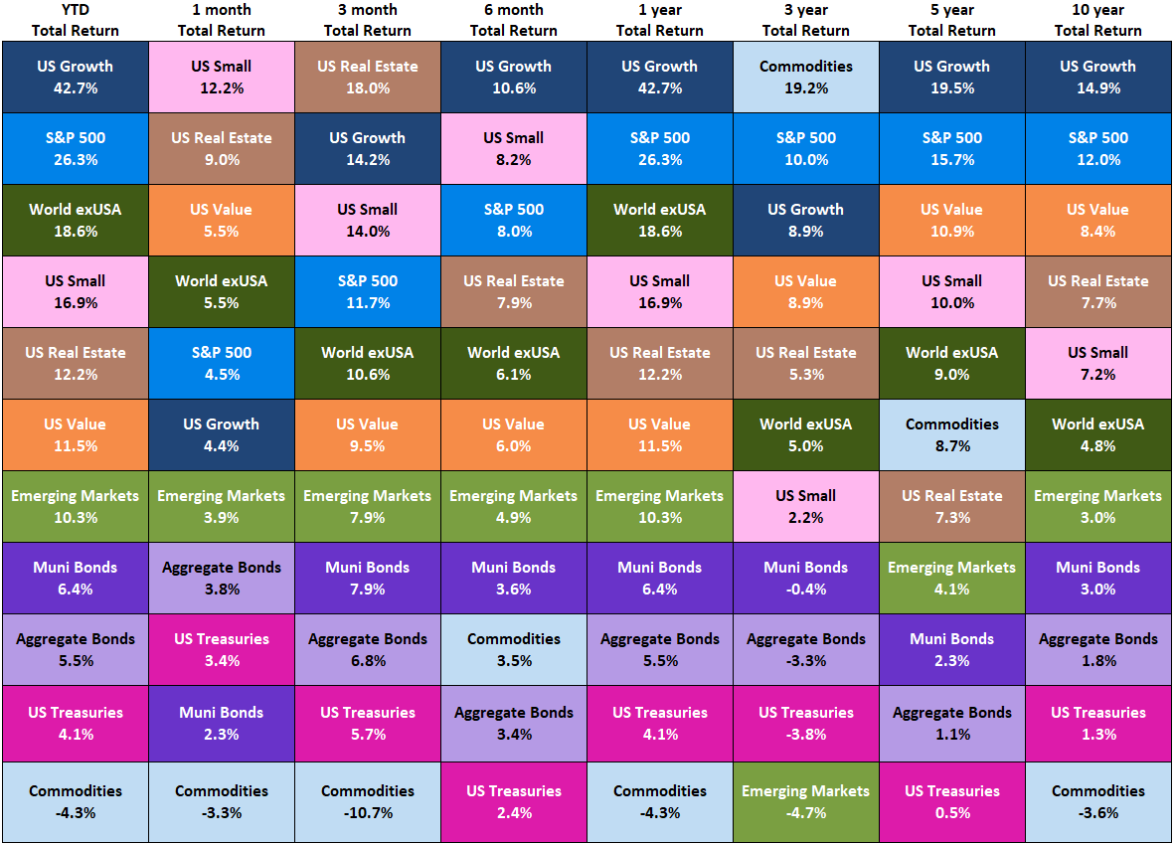
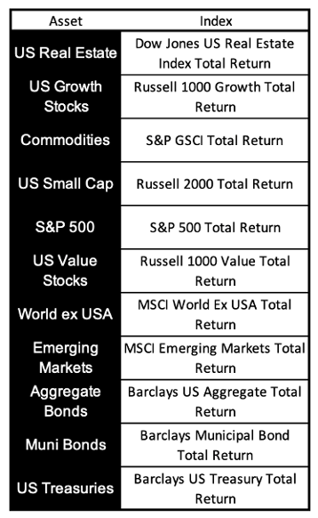
Asset Class Performance – Trailing Periods
3Y, 5Y, 10Y total returns annualized
Notes:
This table shows the performance of asset classes over different time frames.
US Growth was the top total returner in 2023, with the S&P 500 coming in second. Commodities was the only asset class that failed to post a positive total return in 2023.

Slide 8
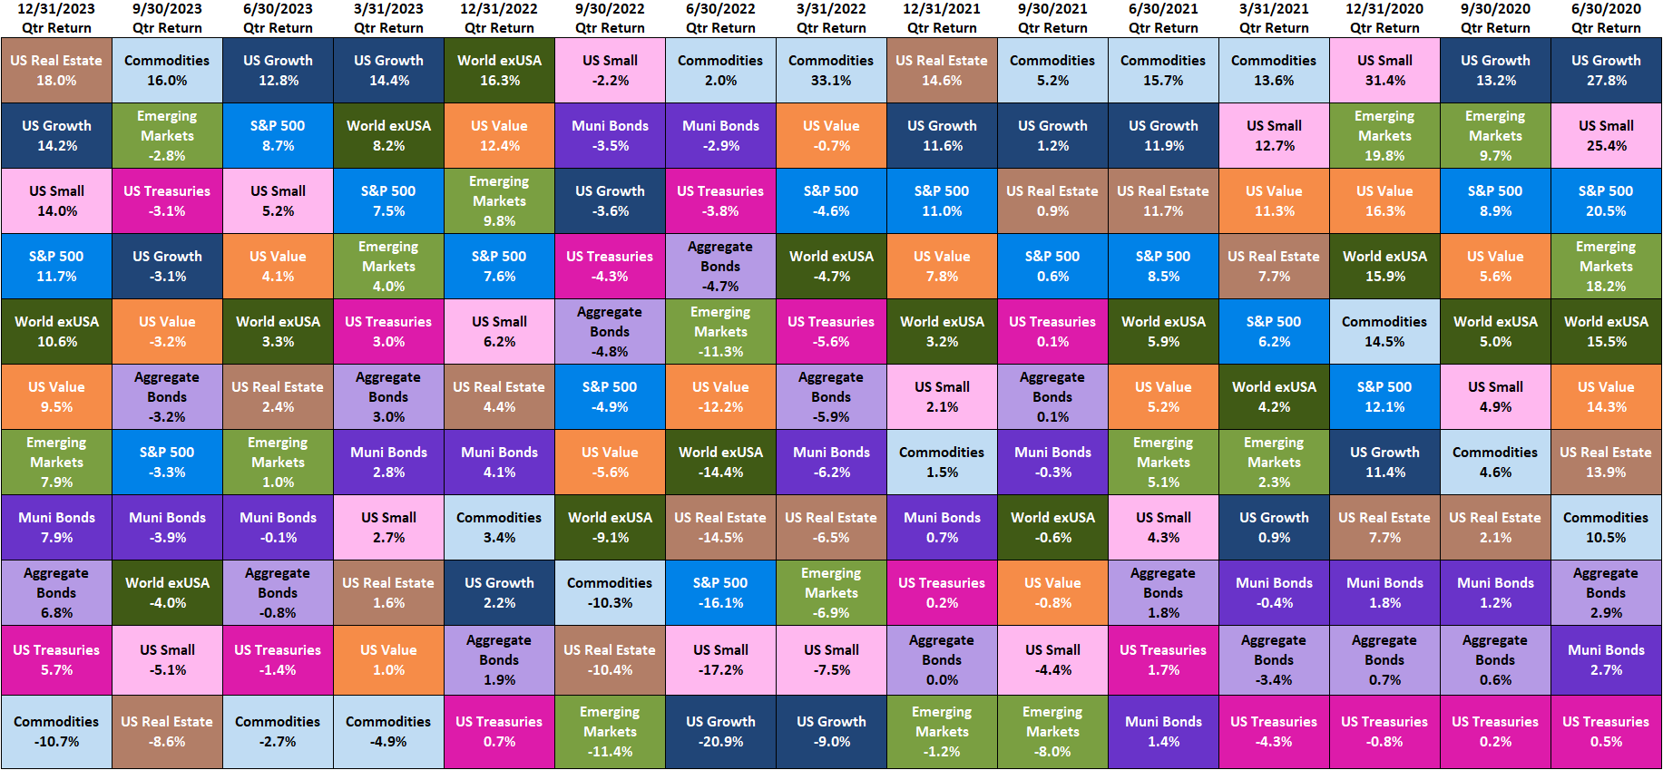
Asset Class Performance – Quarter by Quarter
Contact support@ycharts.com to access these asset class performance quilts
Notes:
This visual shows historical quarterly asset class performance for the last 15 quarters.
Q4 2023 Total Returns:
US Real Estate: +18.0%
US Growth: +14.2%
US Small Caps: +14.0%
S&P 500: +11.7%
World exUSA: +10.6%
US Value: +9.5%
Emerging Markets: +7.9%
Muni Bonds: +7.9%
Aggregate Bonds: +6.8%
US Treasuries: +5.7%
Commodities: -10.7%

Slide 9
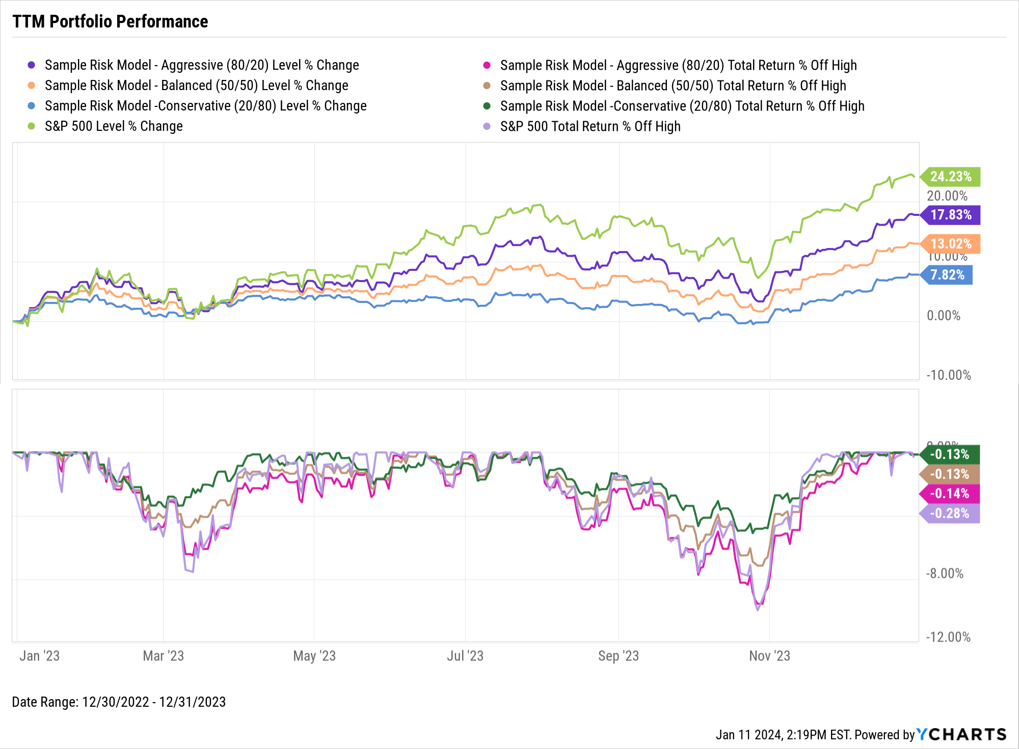
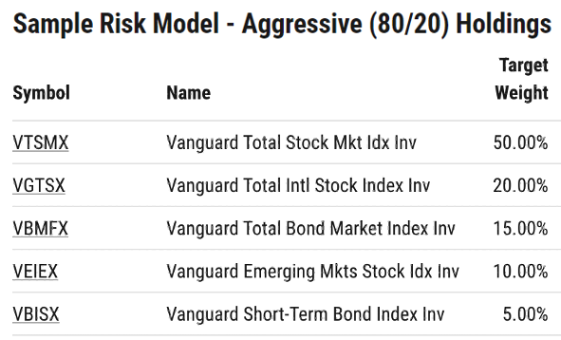
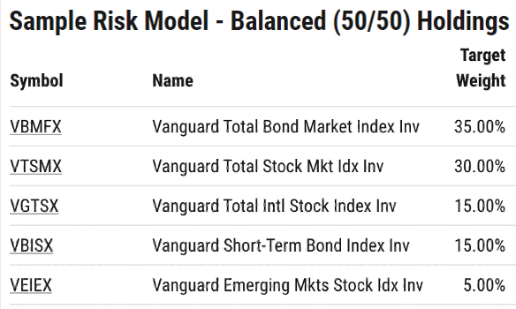
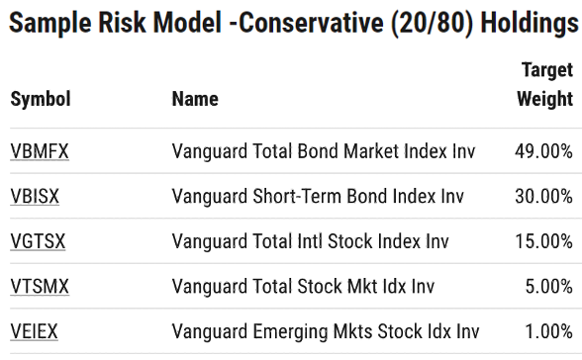
Performance of Diversified Portfolios
Notes:
This slide points out TTM total returns (top) and max drawdowns (bottom) of various risk vs. return strategies, including stock-to-bond allocations of 80/20, 50/50, 20/80, and 100/0 (S&P 500).
TTM Allocation Total Returns, 12/31/2022 – 12/31/2023:
All-S&P 500 Portfolio: +24.23%
Aggressive (80/20): +17.83%
Balanced (50/50): +13.02%
Conservative (20/80): +7.82%
This visual demonstrates the value that diversification can provide investors during turbulent periods for both the stock and bond market.

Slide 10
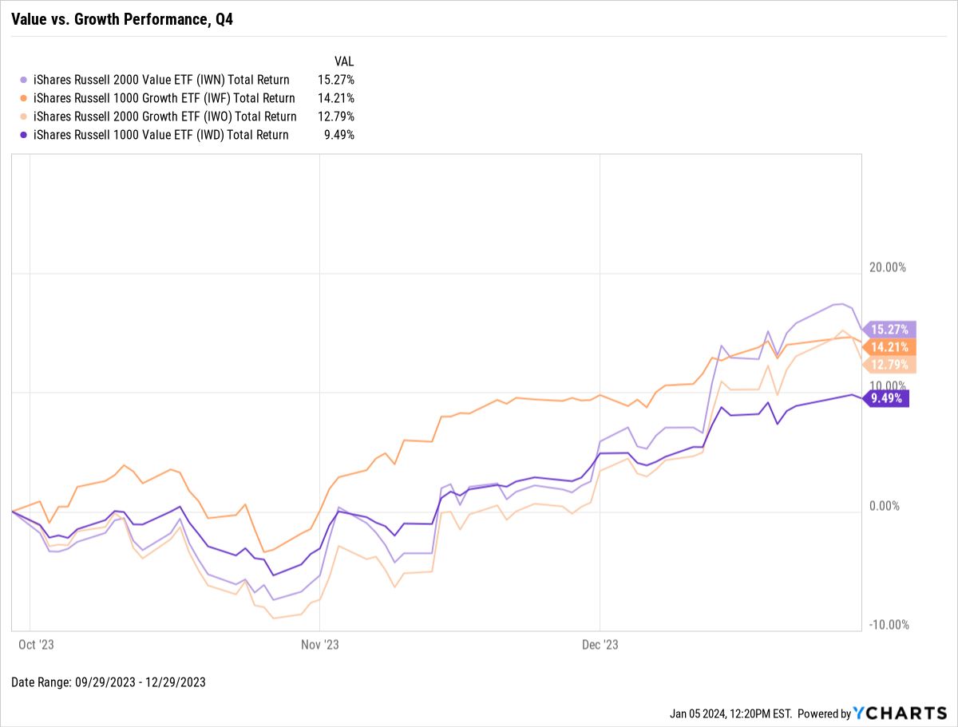
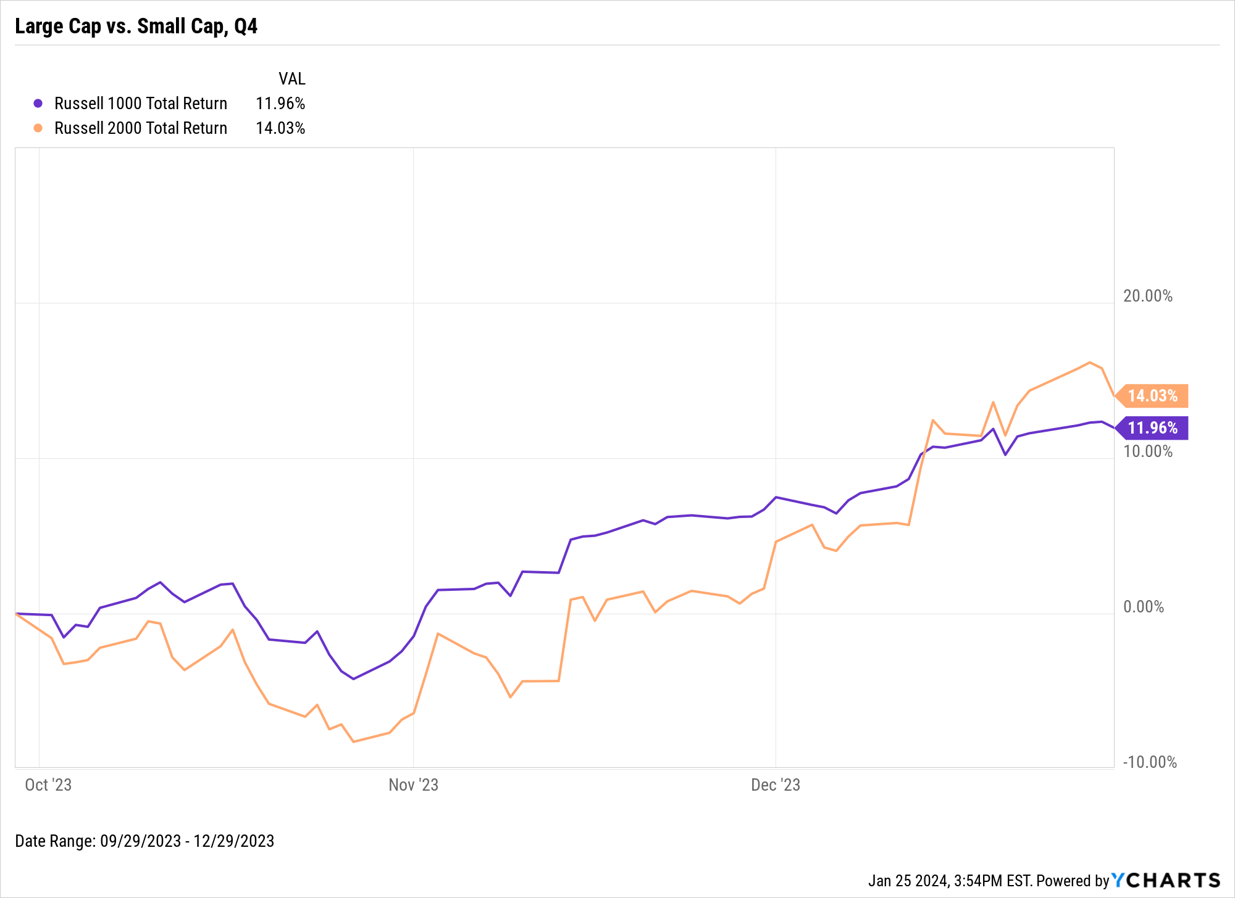
Equity Style Performance
Notes:
L: Style Box Total Returns for Q4 2023:
Large-Cap Value: +9.49%
Large-Cap Growth: +14.21%
Small-Cap Value: +15.27%
Small-Cap Growth: +12.79%
R: Index Total Returns for Q4 2023:
Russell 1000: +11.96%
Russell 2000: +14.03%

Slide 11
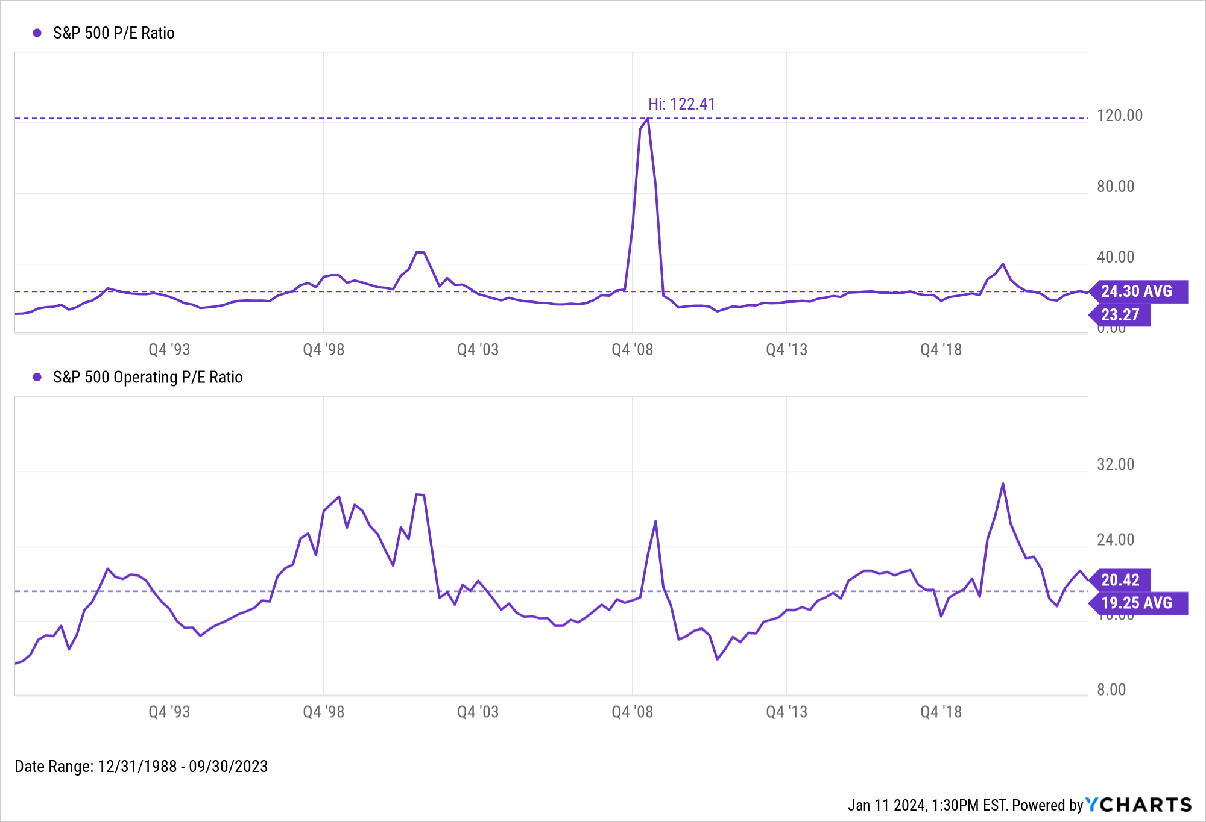
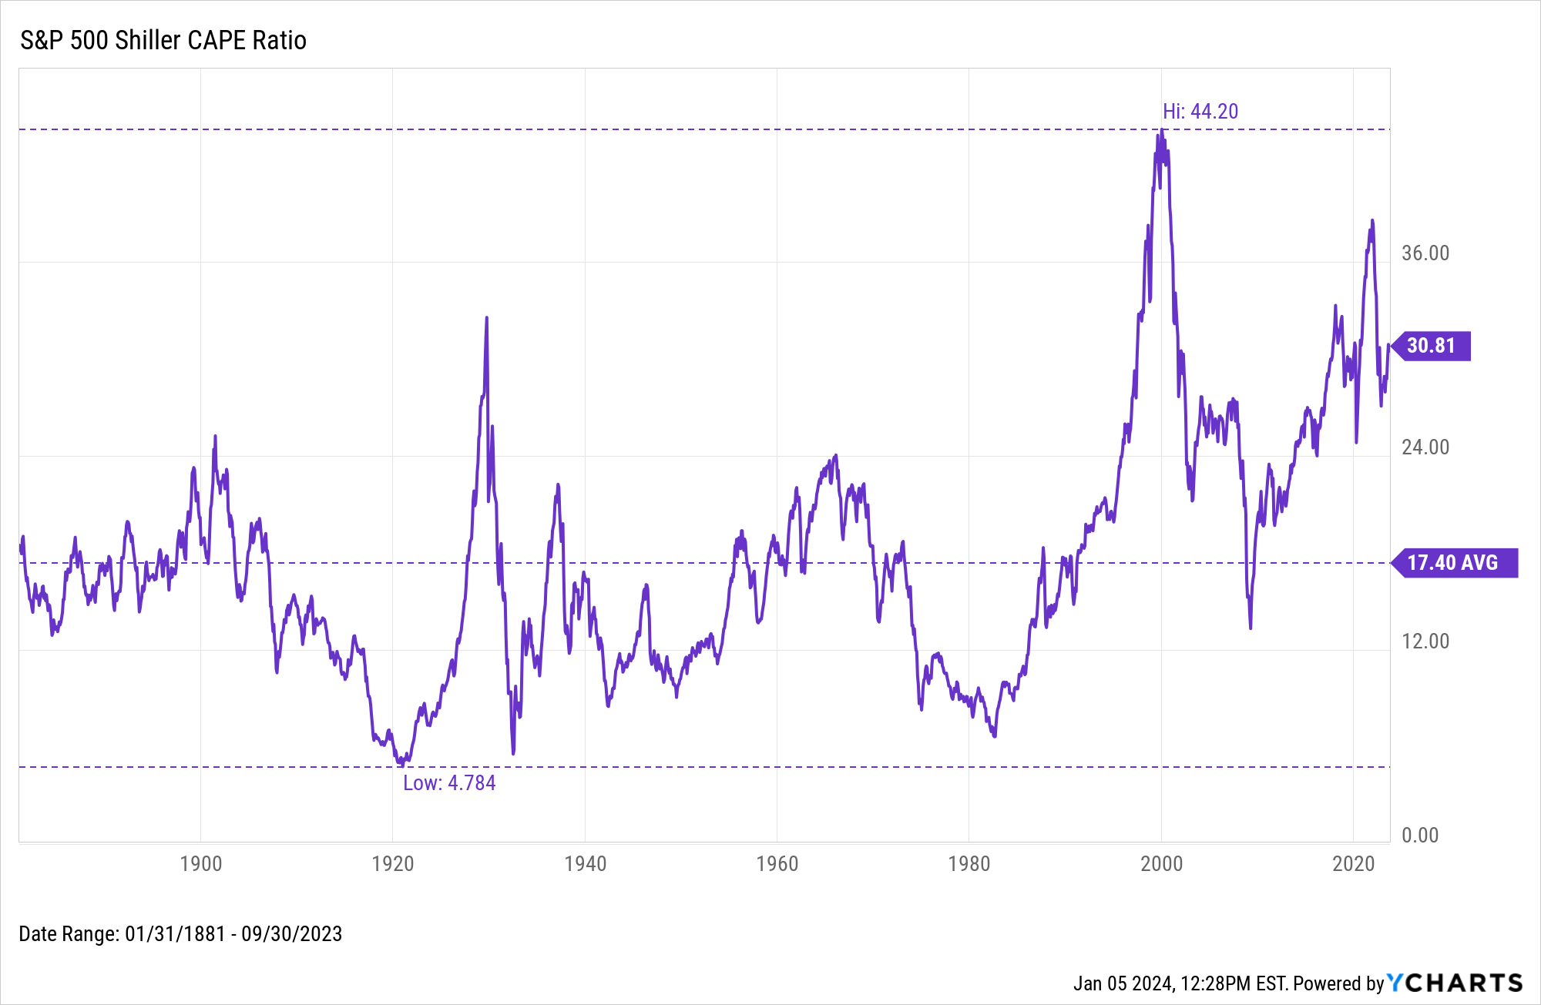
S&P 500 Valuation Measures
Notes:
S&P 500 Valuations as of September 30th, 2023:
S&P 500 CAPE Ratio: 30.81 (Above historical average)
S&P 500 P/E Ratio: 24.30 (Above historical average)
S&P 500 Operating P/E Ratio: 20.42 (Above historical average)

Slide 12
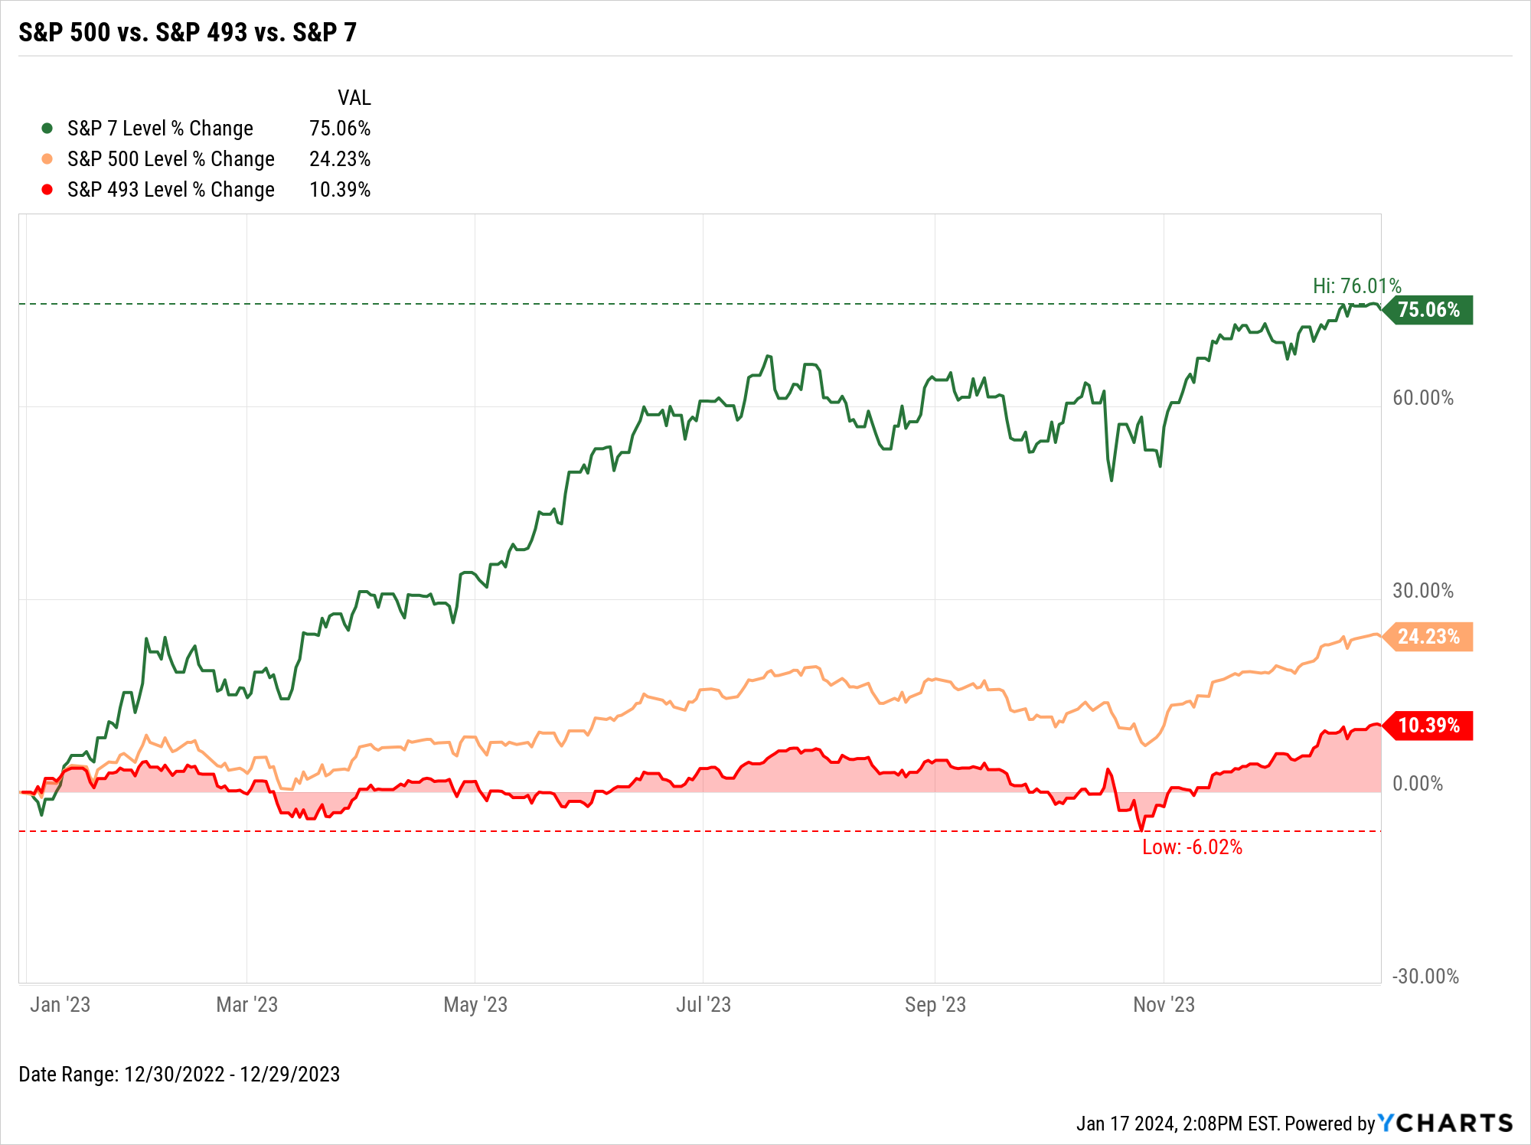
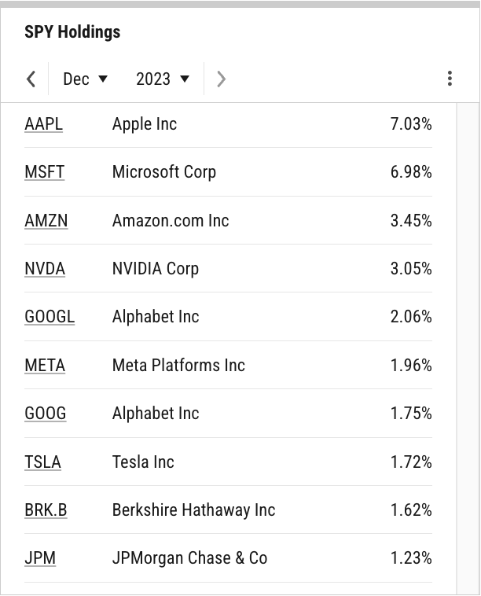
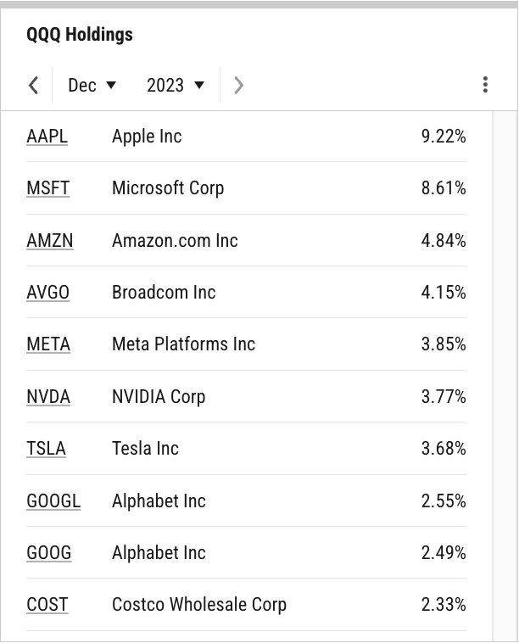
Index Concentration
SPY Top 10 Holdings
QQQ Top 10 Holdings
Top 10 = 30.85% of SPY
Top 10 = 45.49% of QQQ
Chart not appearing in your browser?
Contact support@ycharts.com to access this visual
Notes:
L: As of December 2023, SPY’s Top 10 Holdings comprise 30.85% of the S&P 500-tracking ETF, while QQQ’s Top 10 Holdings make up almost half of the Nasdaq-indexed ETF.
R: The “Magnificent Seven”, sometimes referred to as the “S&P 7”, is comprised of Apple (AAPL), Amazon.com (AMZN), Alphabet (GOOG, GOOGL), Meta Platforms (META), Microsoft (MSFT), NVIDIA (NVDA), and Tesla (TSLA). The Mag 7 was up a staggering 75.1% as a collective on a market-cap weighted basis. Meanwhile, the remaining “S&P 493” finished only 10.4% higher in 2023, and was actually negative at various times on a YTD basis.

Slide 13
Macroeconomic Data
Leading and Lagging Economic Data and Trends from Key Economic Reports Published Recently

Slide 14
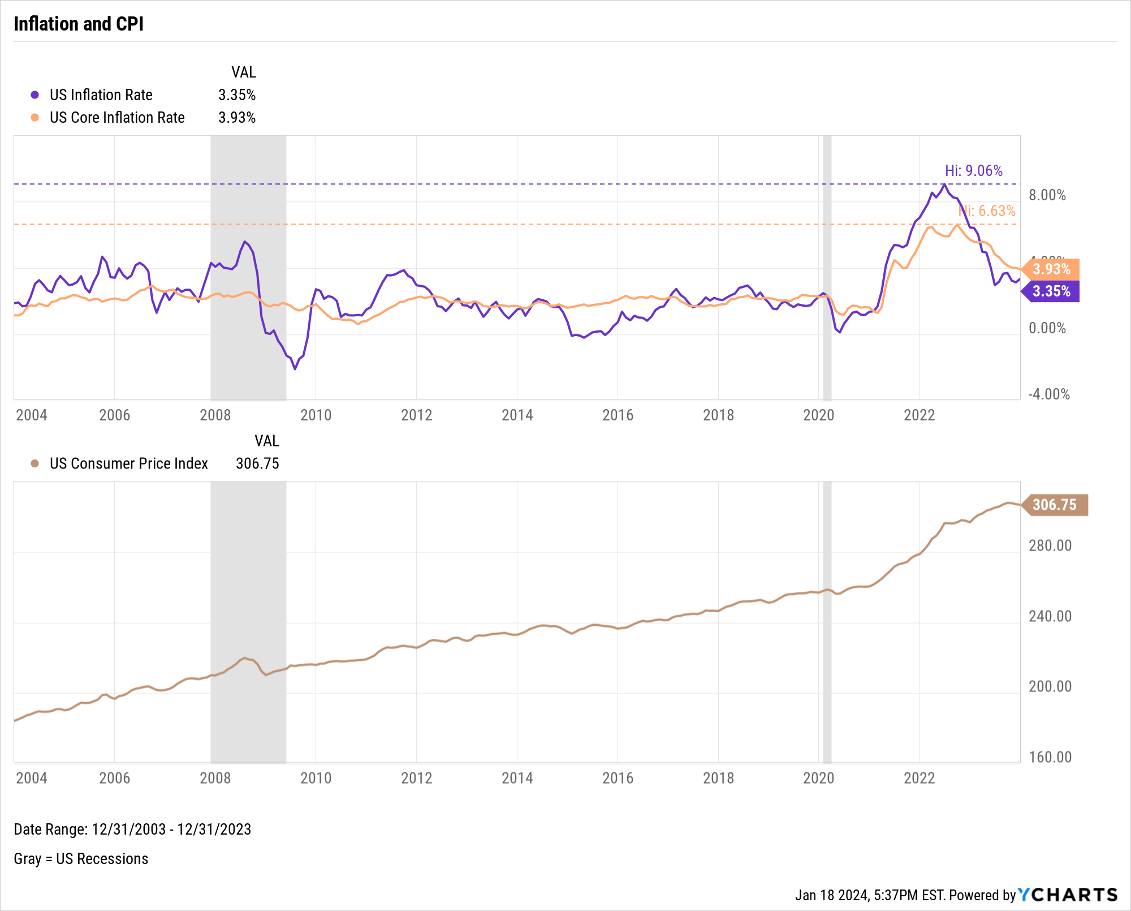
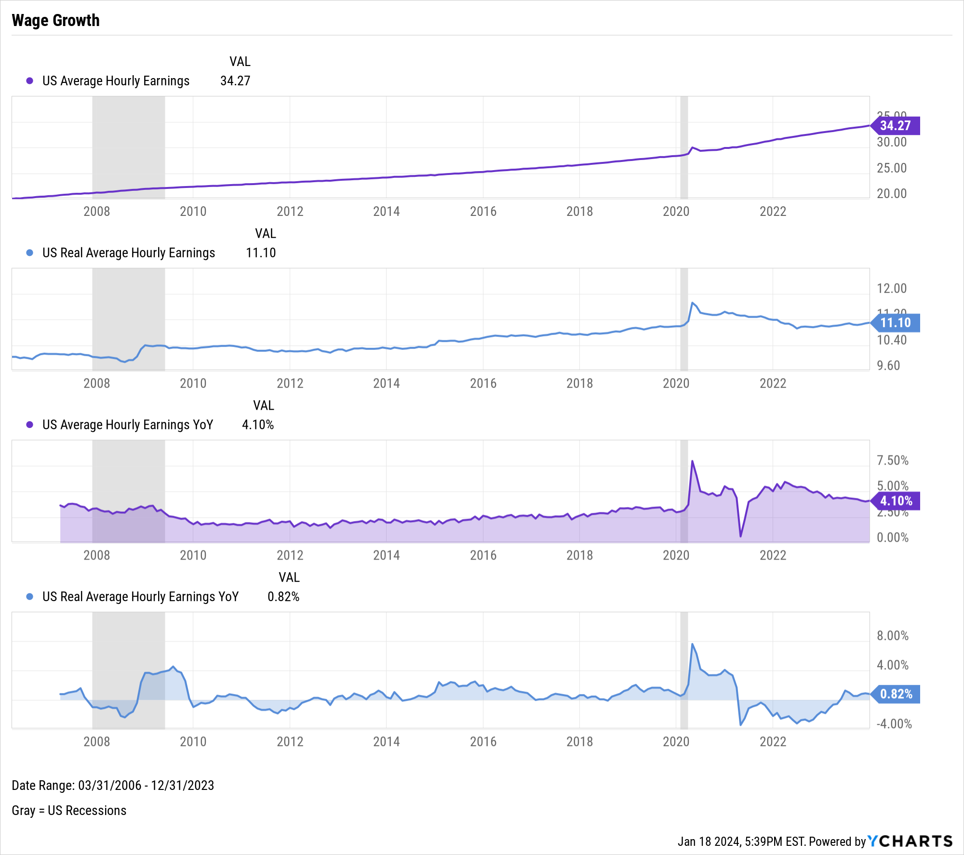
Inflation & Wage Growth
Notes:
L: As of December 2023:
US Inflation Rate: 3.35%
US Core Inflation Rate: 3.93%
US Consumer Price Index: 306.75
R: Though YoY US (nominal) Average Hourly Earnings have been on a decline since March 2022, YoY Real Average Hourly Earnings (adjusted for inflation) just logged its eighth consecutive monthly increase in December 2023. This means that Real Average Hourly Earnings have outpaced inflation each month since May, marking a turnaround in wage growth following 25 consecutive YoY decreases prior to May.

Slide 15
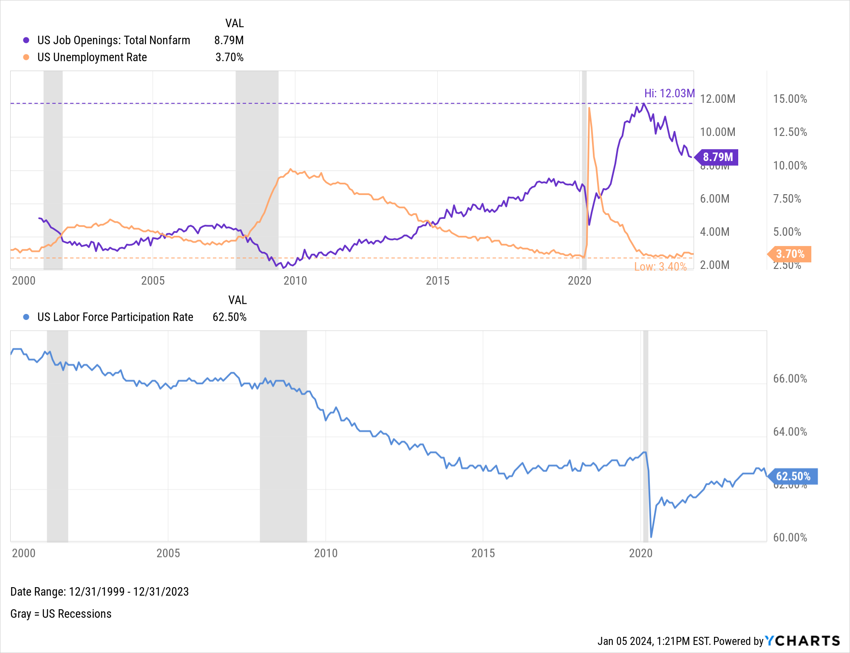
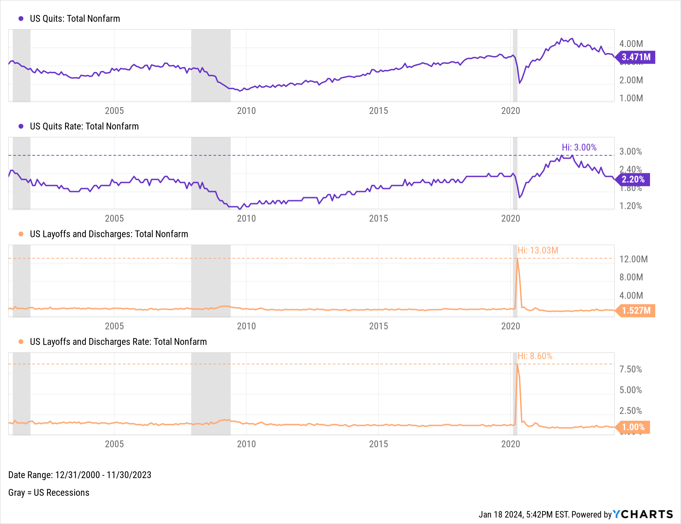
Employment
Notes:
L: As of December 2023:
Total US Job Nonfarm Openings: 8.79M
US Unemployment Rate: 3.70%
US Labor Force Participation Rate: 62.50%
R: As of November 2023:
US Quits: 3.471M
US Quits Rate: 2.20%
US Layoffs and Discharges: 1.527M
US Layoffs and Discharges Rate: 1.00%

Slide 16
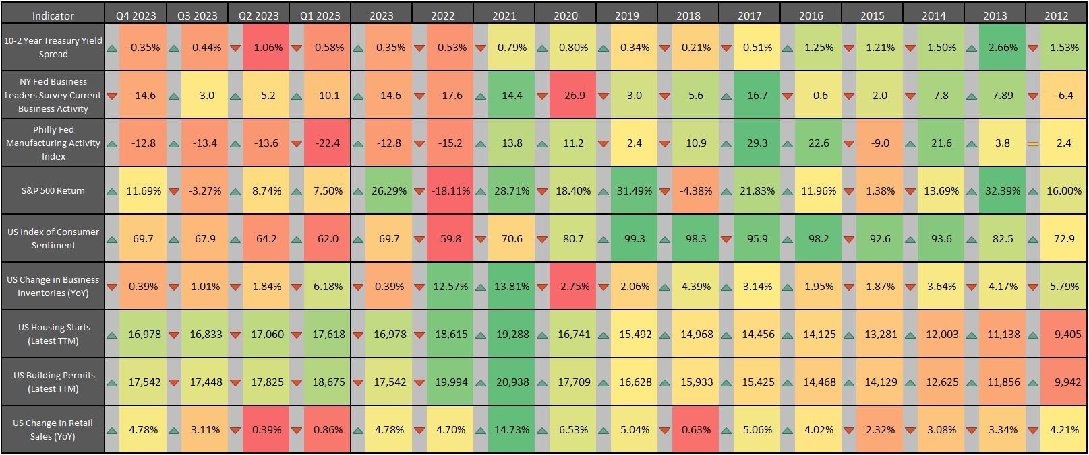
Leading Indicator Data and Trends
Contact support@ycharts.com to access this heatmap
Notes:
Latest values as of December 2023/Q4 2023:
10-2 Year Treasury Yield Spread: -0.35%
NY Fed Business Leaders Survey Current Business Activity: -14.6
Philly Fed Manufacturing Activity Index: -12.8
S&P 500 Return: 11.69% for Q4 2023
US Index of Consumer Sentiment: 69.7
US Change in Business Inventories YoY: -0.39%
US Housing Starts (Latest TTM): 16,978
US Building Permits (Latest TTM): 17,542
US Change in Retail Sales YoY: 4.78%

Slide 17
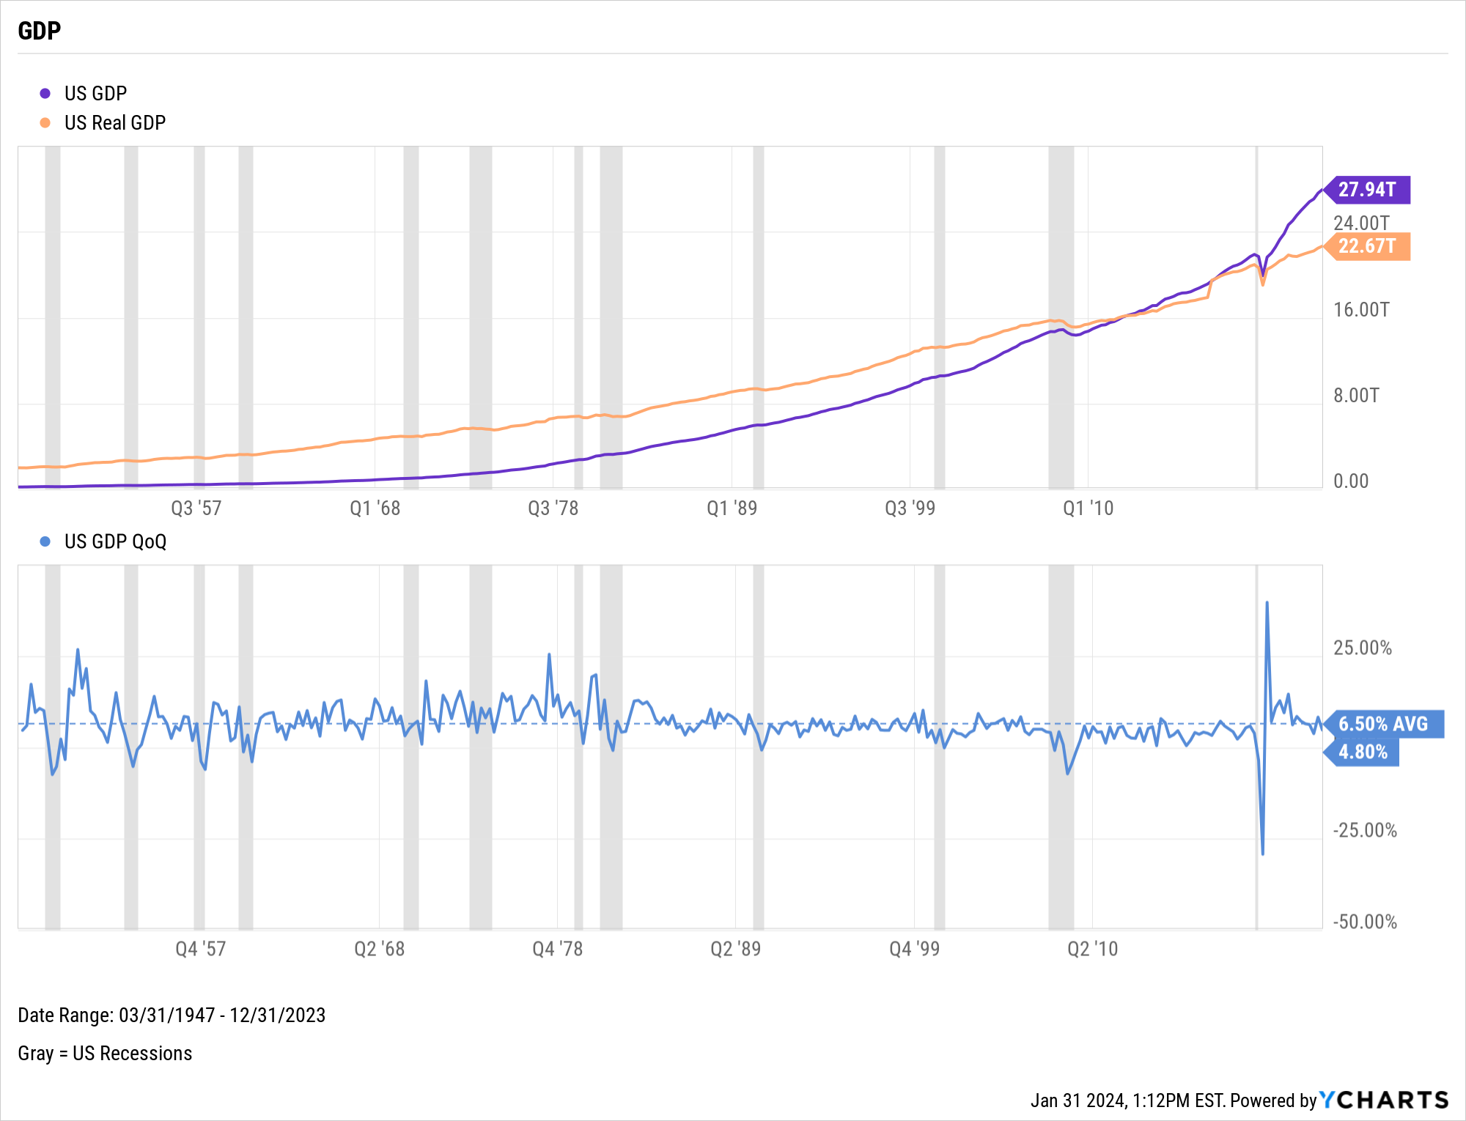
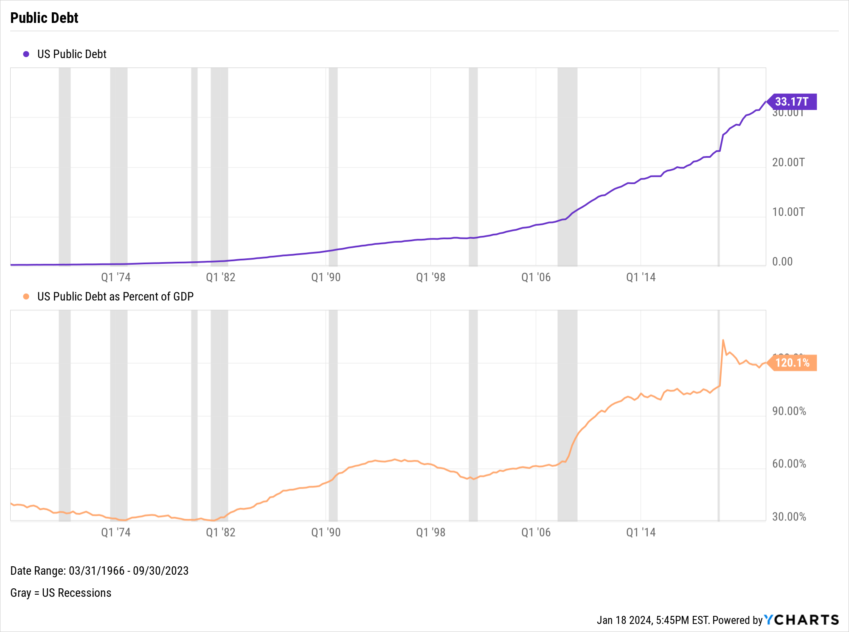
GDP & Public Debt
Notes:
L: As of Q4 2023:
US GDP: $27.94T
US Real GDP: $22.67T
US GDP % change, Q3 to Q4: 4.80%
R: As of Q3 2023:
US Public Debt: $33.17T
US Public Debt as a Percent of GDP: 120.1%

Slide 18
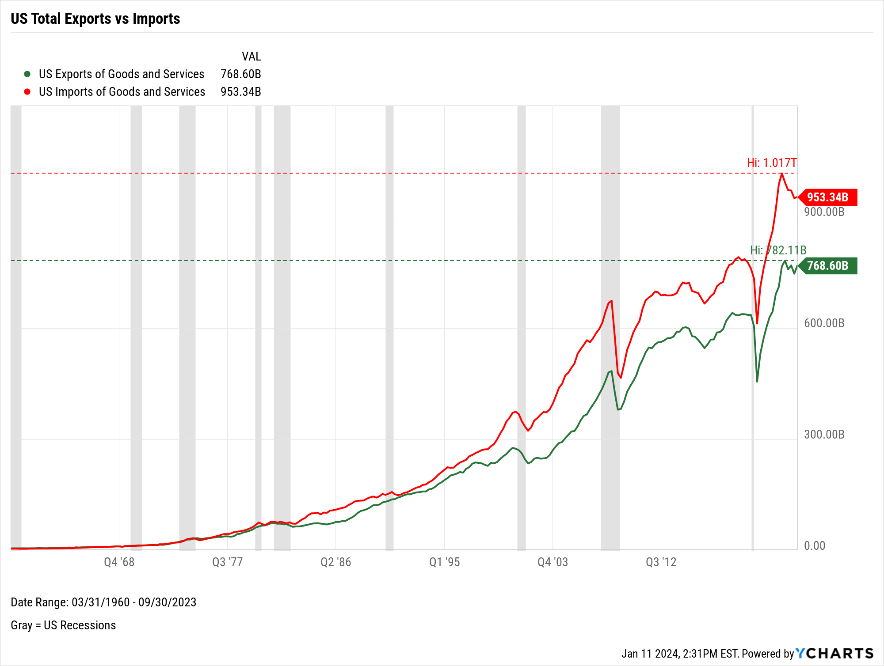
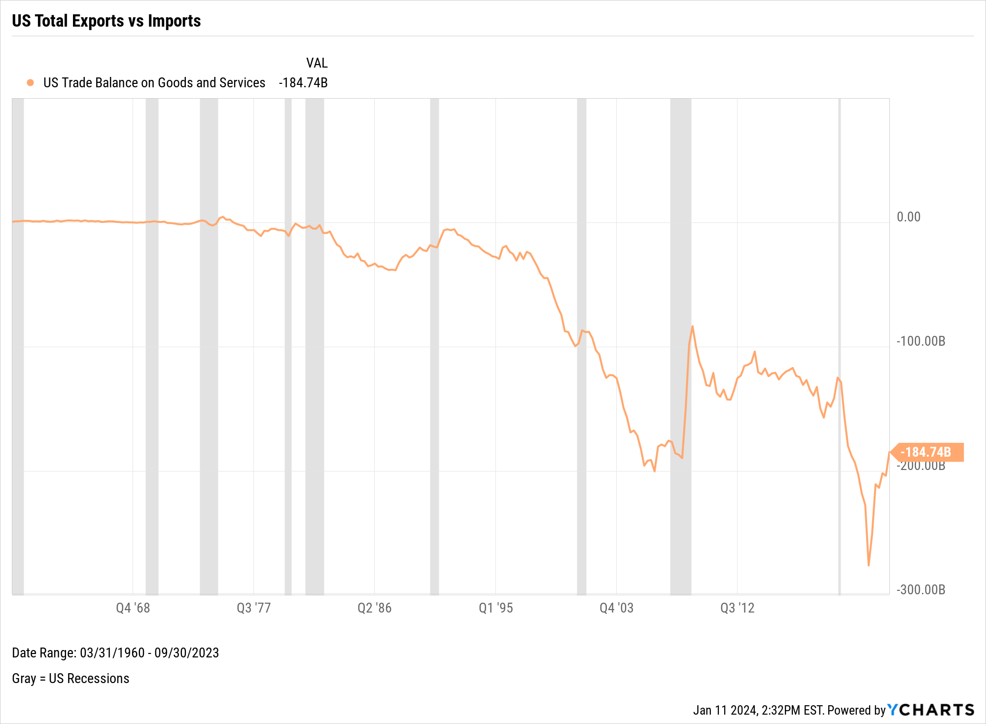
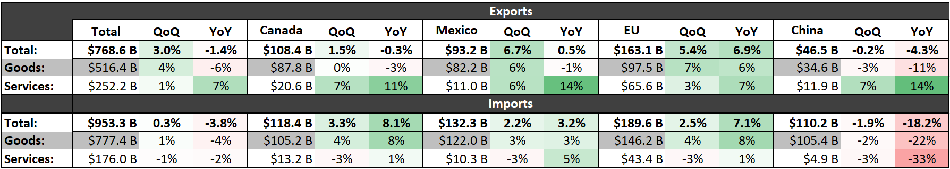
US Trade Balance
Notes:
This slide shows the US trade activity through Q3 2023 (the latest data available).
L:
US Exports of Goods and Services: $768.60B
US Imports of Goods and Services: $953.34B
R:
US Trade Balance between Goods and Services: -$184.74B
The table at the bottom shows trade activity between the USA and other key partners for Q3 2023. For example, the US saw $110.2B worth of combined goods and services imports from China in Q3 2023, which is 18.2% less than that same figure a year ago from Q3 2022.

Slide 19
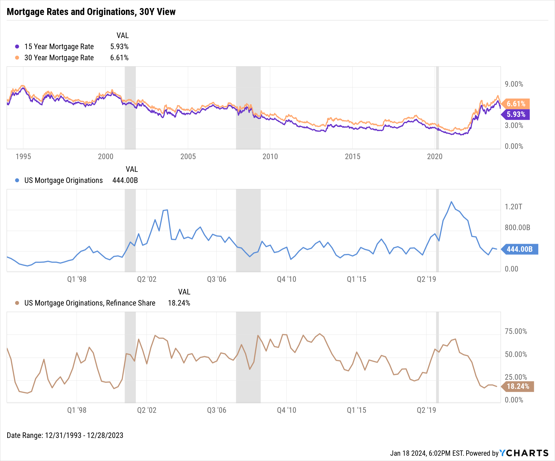
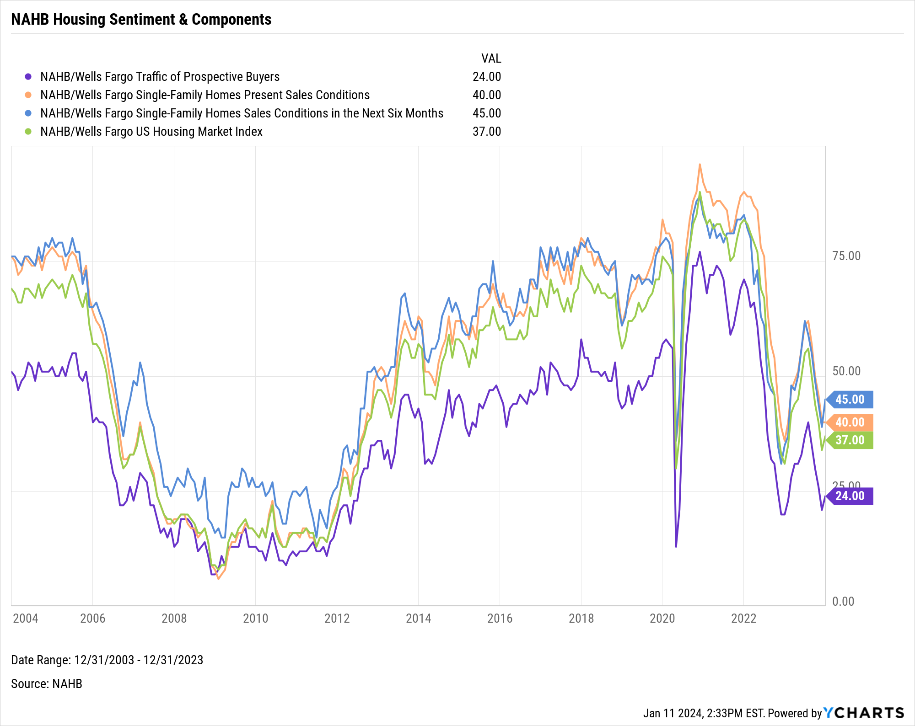
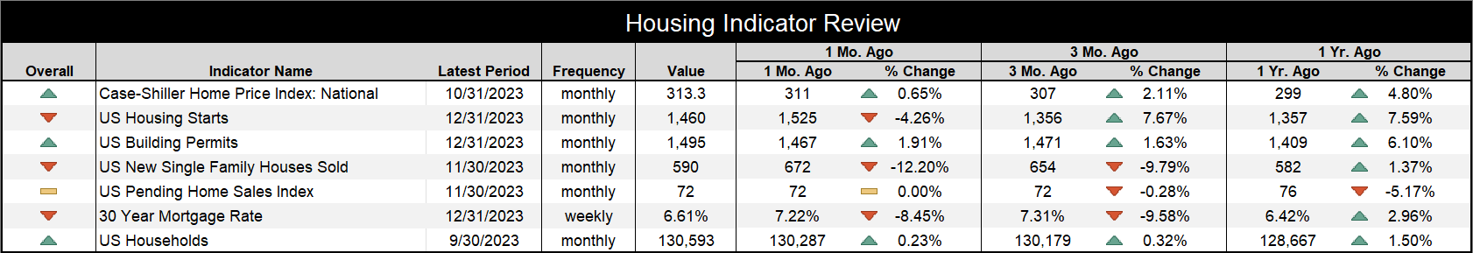
US Housing Market Data
Notes:
L: As of December 2023:
15-Year Mortgage Rate: 5.93%
30-Year Mortgage Rate: 6.61%
US Mortgage Originations: $444B
US Mortgage Originations, Refinance Share: 18.24%
R: NAHB/Wells Fargo data as of December 2023:
Traffic of Prospective Buyers: 24.00
Single-Family Homes Present Sales Conditions: 40.00
Single-Family Homes Sales Conditions in the Next Six Months: 45.00
US Housing Market Index: 37.00
Table:
National Case-Shiller Home Price Index: 313.3 (10/31/2023)
US Housing Starts: 1,460 (12/31/2023)
US Building Permits: 1,495 (12/31/2023)
US New Single Family Houses Sold: 590 (11/30/2023)
US Pending Home Sales Index: 72 (11/30/2023)
30-Year Mortgage Rate: 6.61% (12/31/2023)
US New Households: 130,593 (9/30/2023)

Slide 20
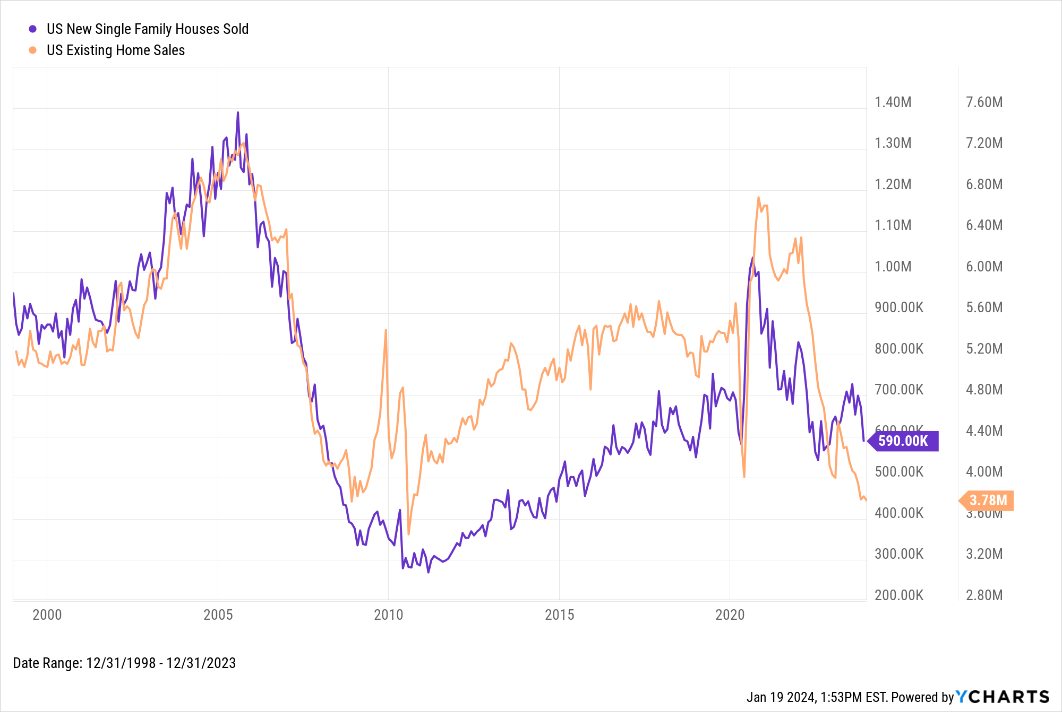
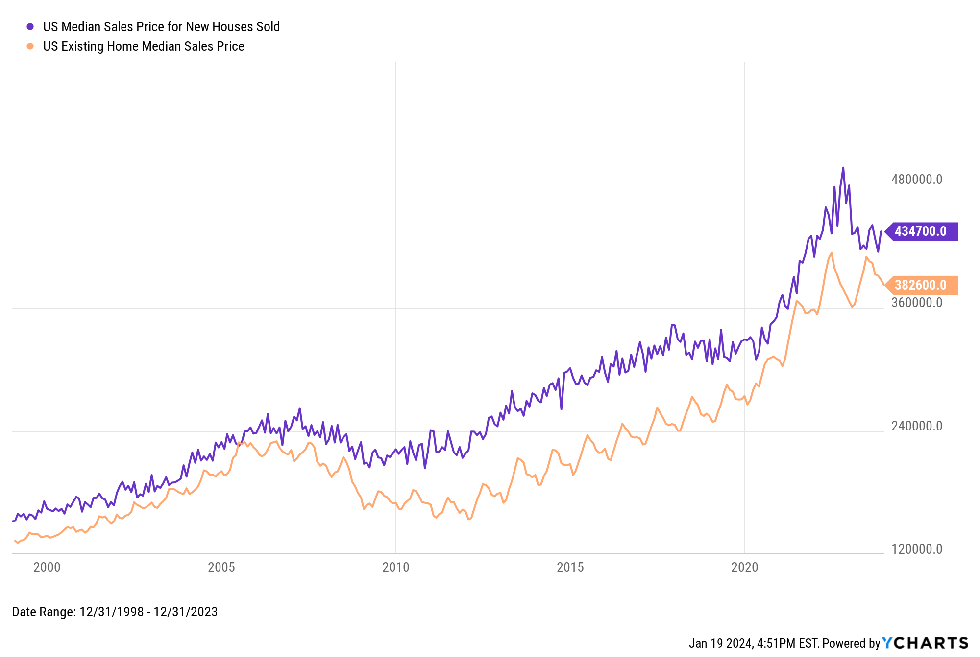
US Housing Market Data (cont’d)
Notes:
L: As of December 2023:
US New Single Family Houses Sold: 590K
US Existing Home Sales: 3.78M
R: As of December 2023:
US Median Sales Price for New Houses Sold: $434,700
US Existing Home Median Sales Price: $382,600

Slide 21
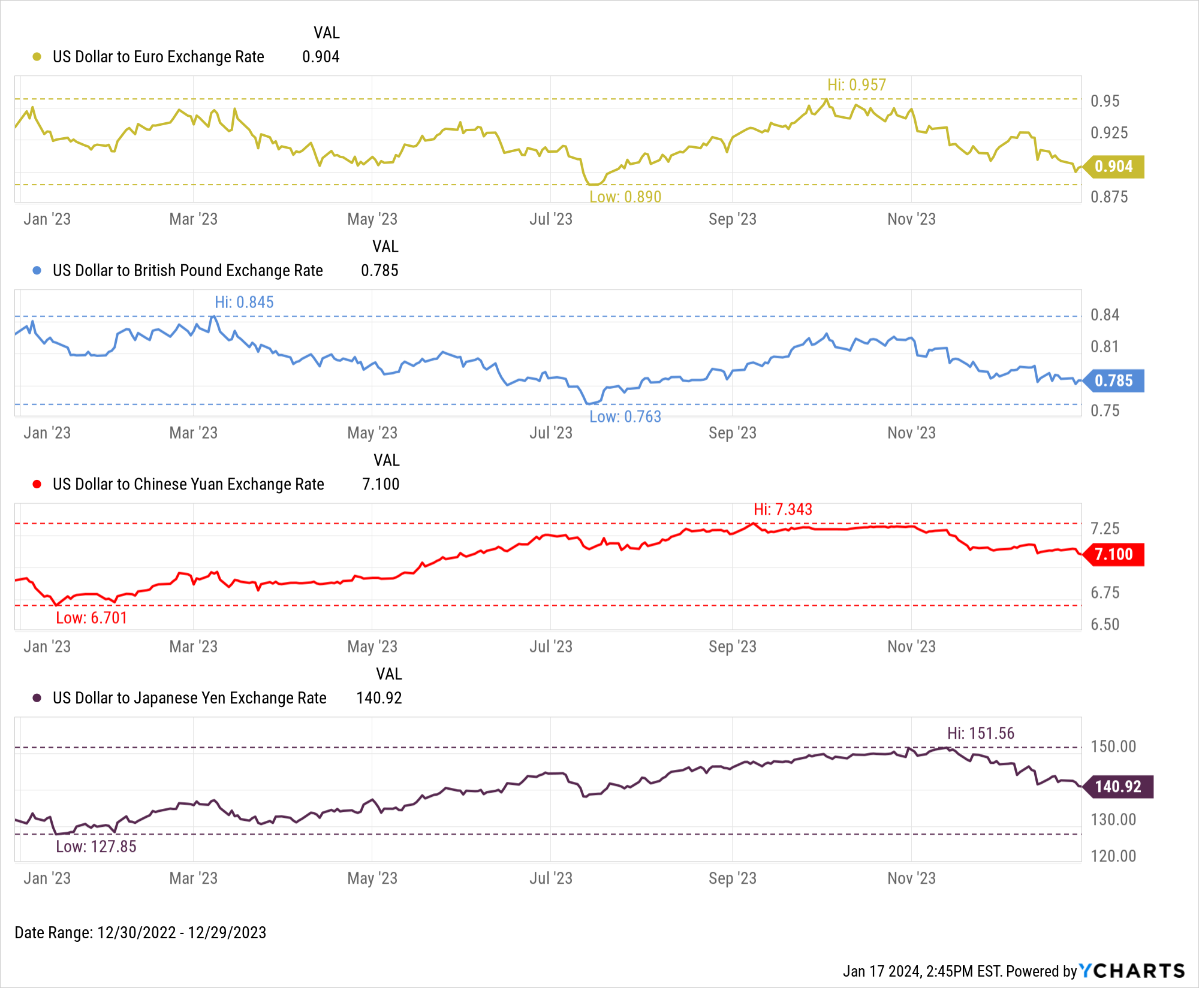
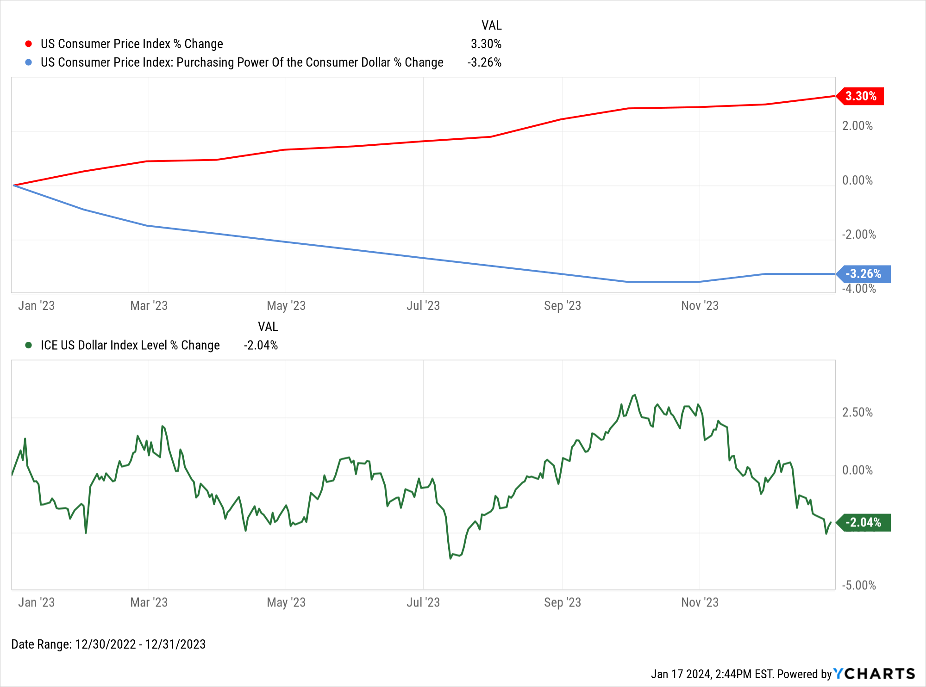
US Dollar Strength
Notes:
L: As of December 31st, 2023:
1Y US CPI % Change: 3.30%
1Y Purchasing Power of the Consumer Dollar % Change: -3.26%
1Y ICE US Dollar Index Level % Change: -2.04%
R: As of December 29th, 2023:
1 USD = 0.904 EUR (0.957 TTM high, 0.890 TTM low)
1 USD = 0.785 GBP (0.845 TTM high, 0.763 TTM low)
1 USD = 7.100 CNY (7.343 TTM high, 6.701 TTM low)
1 USD = 140.92 JPY (151.56 TTM high, 127.85 TTM low)

Slide 22
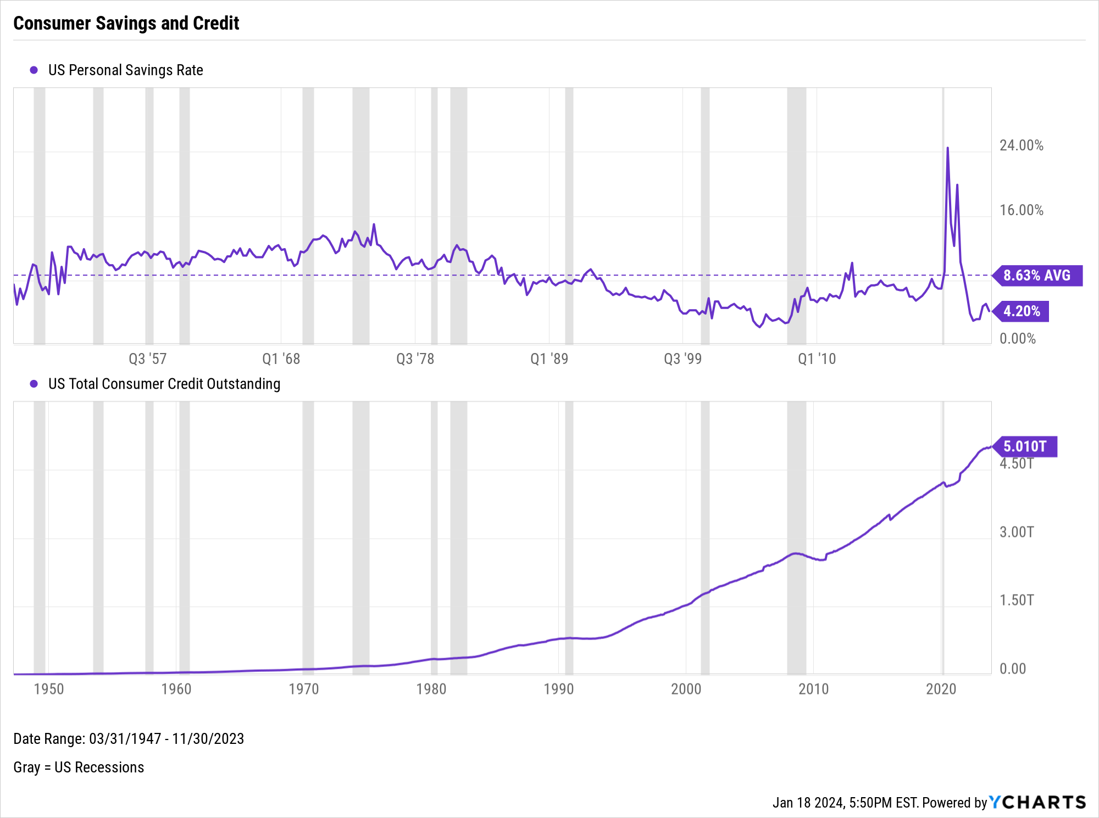
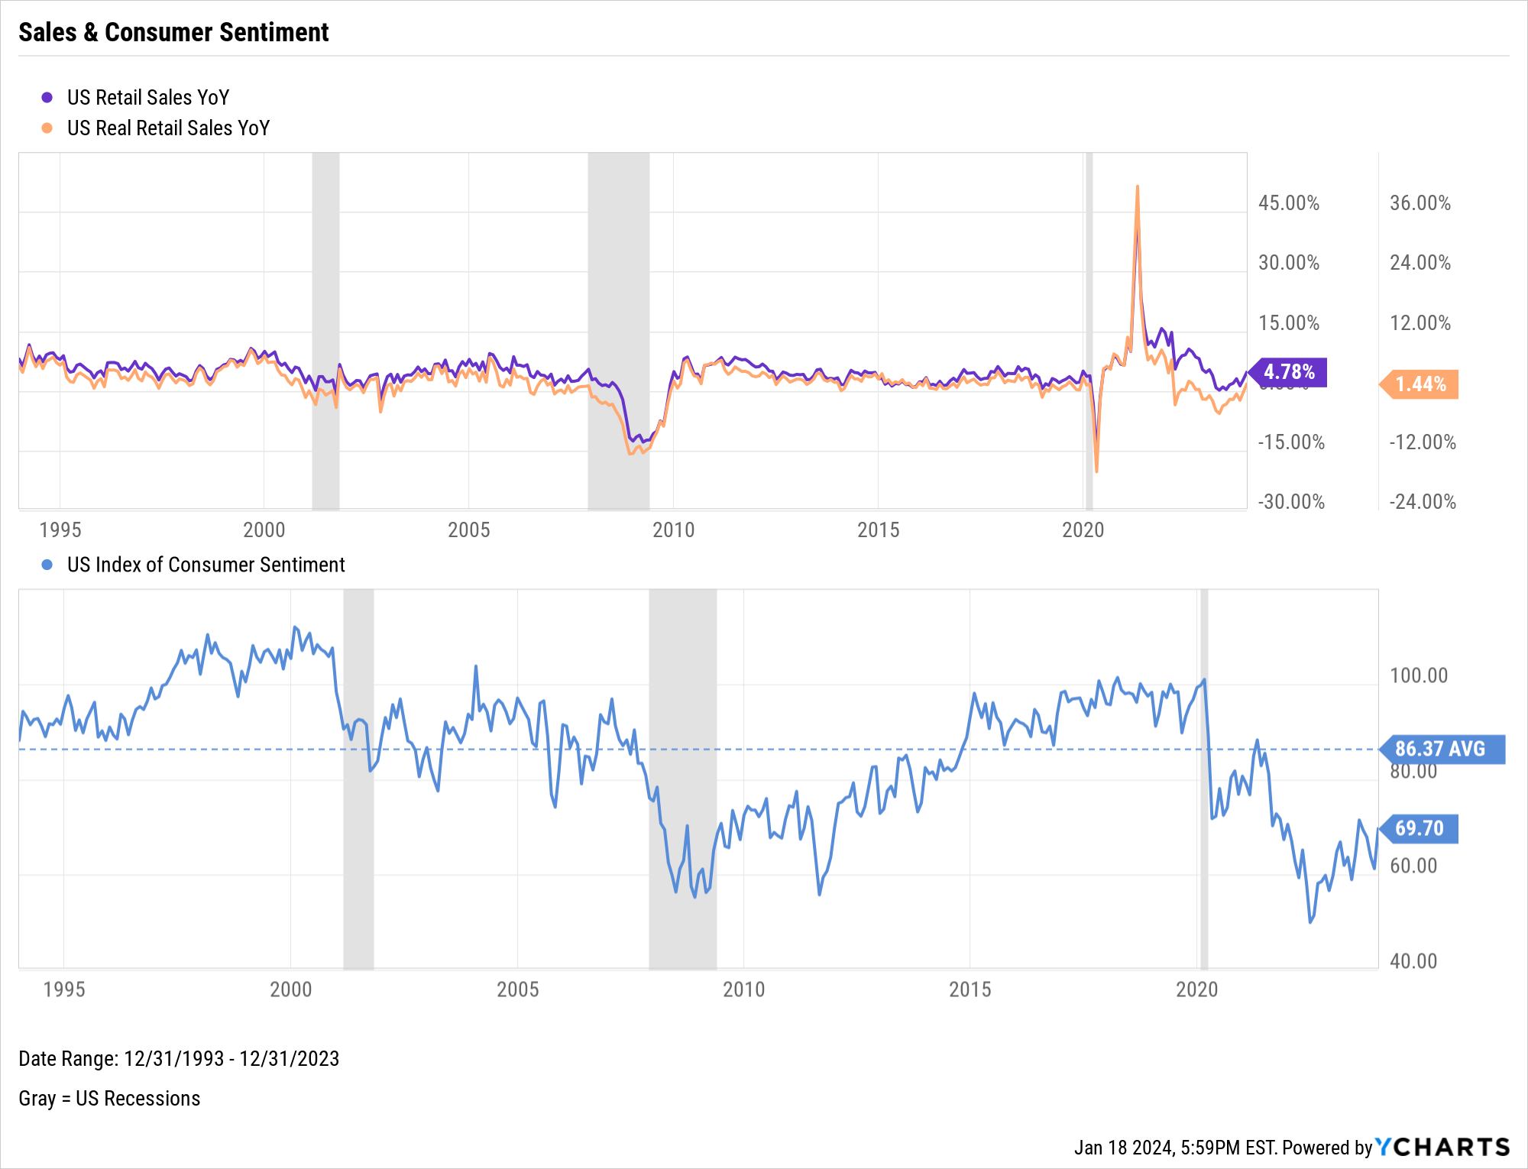
Consumers
Notes:
L: As of November 2023:
US Personal Savings Rate: 4.20% (Below historical average)
US Total Consumer Credit Outstanding: $5.01T (first time above $5 trillion)
R: As of December 2023:
US Retail Sales YoY: 4.78%
US Real Retail Sales YoY: 1.44%
US Index of Consumer Sentiment: 69.70 (Below historical average)

Slide 23
Bonds & Interest Rates
Collection of Data Summarizing Moves in the Fixed Income Markets over the Last Quarter

Slide 24
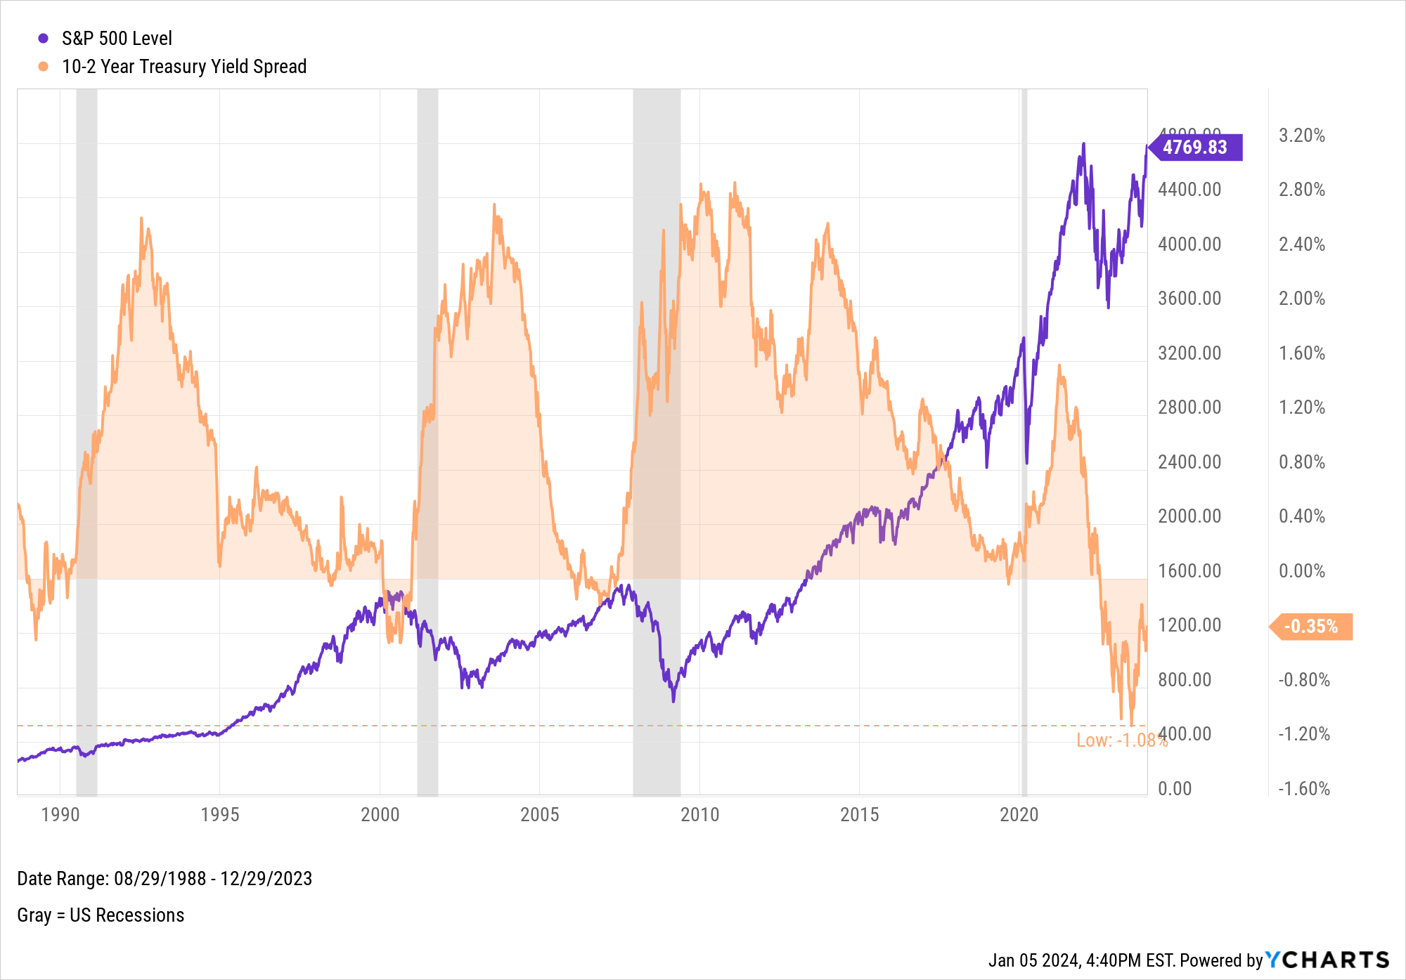
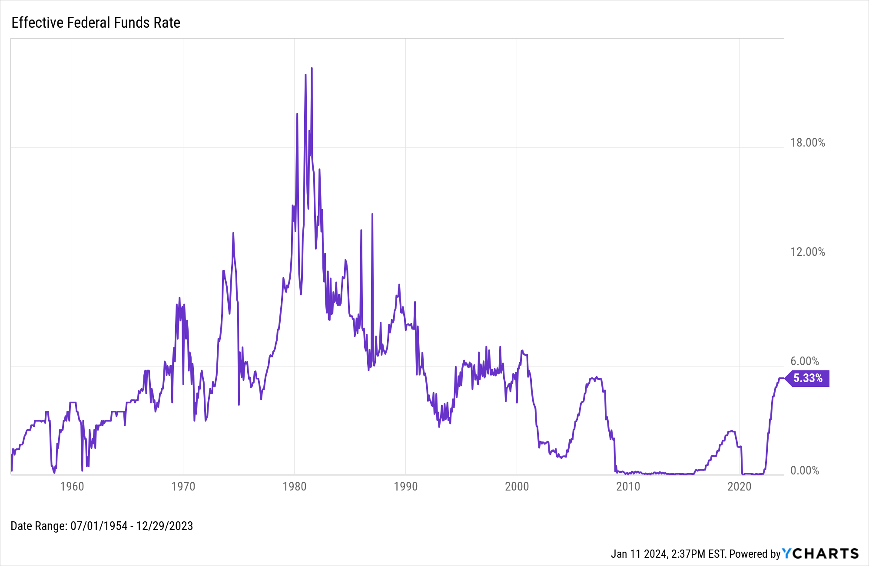
Interest Rates & Spreads
Notes:
L:
Effective Federal Funds Rate as of 12/29/2023: 5.33%
Current Target Upper Limit Fed Funds Rate: 5.50%
R: As of December 29th, 2023:
S&P 500 Level: 4769.83
10-2 Year Treasury Yield Spread: -0.35% (Inverted since July 2022)

Slide 25
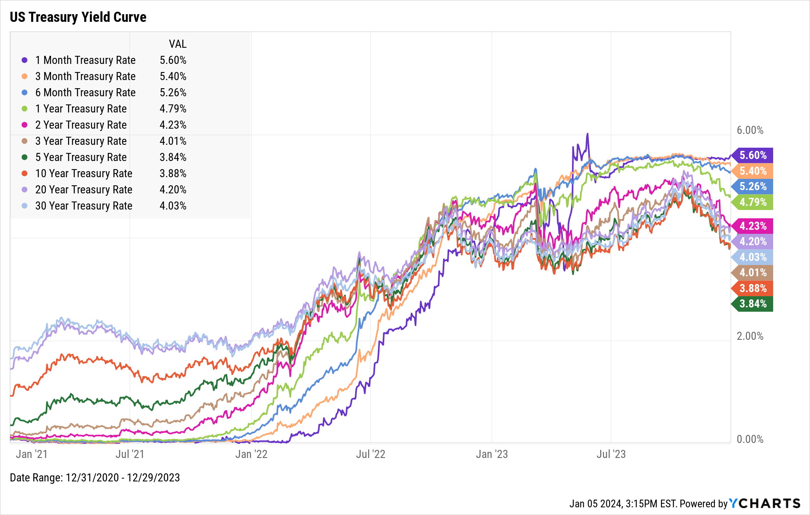
Yield Curve Summary
Duration | Rate | QoQ Δ
1-Month | 5.60% | ▲ 5 bps
3-Month | 5.40% | ▼ 15 bps
6-Month | 5.26% | ▼ 27 bps
1-Year | 4.79% | ▼ 67 bps
2-Year | 4.23% | ▼ 80 bps
3-Year | 4.01% | ▼ 79 bps
5-Year | 3.84% | ▼ 76 bps
10-Year | 3.88% | ▼ 71 bps
20-Year | 4.20% | ▼ 72 bps
30-Year | 4.03% | ▼ 70 bps
Notes:
Duration: 12/31 9/30 QoQ ∆
1 Month 5.60% 5.55% 5 bps
3 Month 5.40% 5.55% -15 bps
6 Month 5.26% 5.53% -27 bps
1 Year Rate 4.79% 5.46% -67 bps
2 Year Rate 4.23% 5.03% -80 bps
3 Year Rate 4.01% 4.80% -79 bps
5 Year Rate 3.84% 4.60% -76 bps
10 Year 3.88% 4.59% -71 bps
20 Year 4.20% 4.92% -72 bps
30 Year 4.03% 4.73% -70 bps

Slide 26
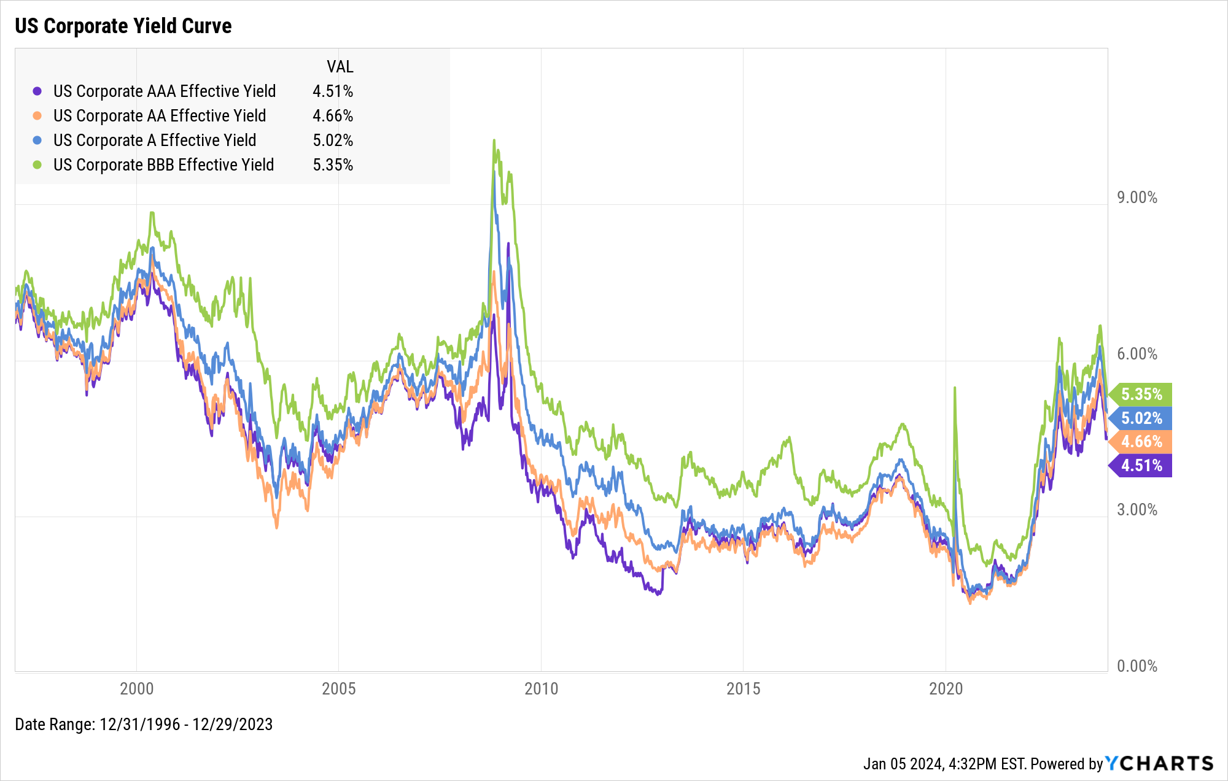
Corporate Yields
Type | Rate | QoQ Δ
AAA | 4.51% | ▼ 79 bps
AA | 4.66% | ▼ 83 bps
A | 5.02% | ▼ 90 bps
BBB | 5.35% | ▼ 98 bps
Notes:
Duration: 12/31 9/30 QoQ ∆
AAA Bond 4.51% 5.30% -79 bps
AA Bond 4.66% 5.49% -83 bps
A Bond 5.02% 5.92% -90 bps
BBB Bond 5.35% 6.33% -98 bps

Slide 27
Charts of the Moment
Visuals Depicting Trends that are Impacting the Markets and Investments

Slide 28

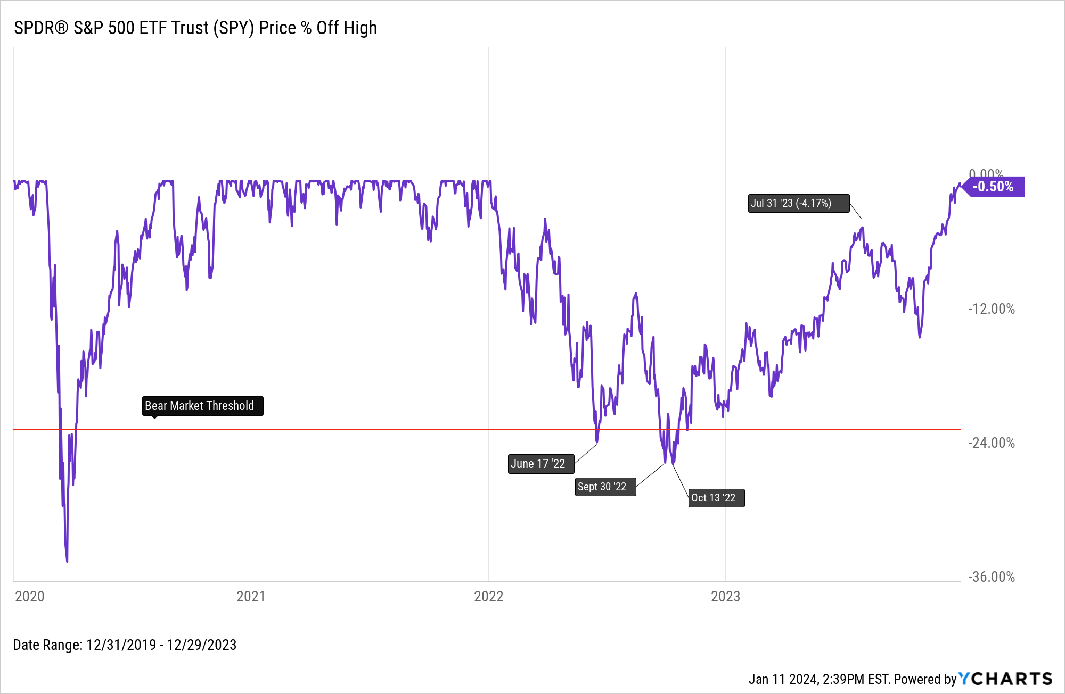
End of the Bull Market
Notes:
The S&P 500, represented here by the SPDR® S&P 500 ETF Trust (SPY), drew down by as much as 25.4% in 2022. Not only did the index emerge out of bear market territory in 2023, but it just about fully erased that drawdown heading into 2024. The S&P 500 index rose 24.3% in 2023, ending the year half a percent away from its all-time high.

Slide 29
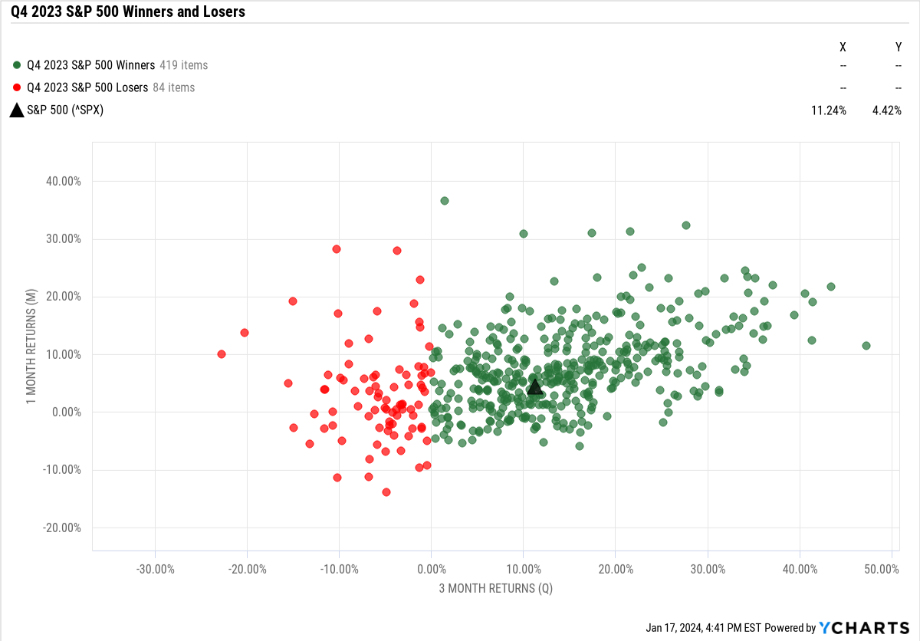
Q4 2023 Winners and Losers
Scatter Plot not appearing in your browser?
Contact support@ycharts.com to access this visual
Notes:
Out of the 503 S&P 500 constituents, 419 of them posted positive returns in Q4 2023. In other words, 5/6ths of the S&P 500 (83.3%) had a good quarter.
The best performer in Q4 was Expedia Group (EXPE), which finished up 47.27% in the quarter. The worst performer? Hasbro (HAS), posting a -22.80% slump in Q4.

Slide 30
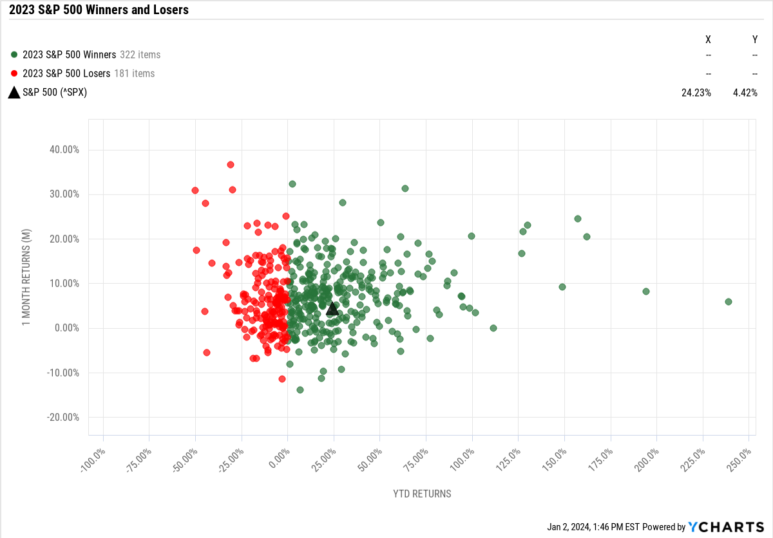
2023 FY Winners and Losers
Scatter Plot not appearing in your browser?
Contact support@ycharts.com to access this visual
Notes:
For the year, 322 of the 503 S&P 500 constituents posted positive returns in 2023. In other words, about two-thirds of the S&P 500 (64%) had a good year.
Who were the best and worst performers in 2023? The best: NVIDIA (NVDA) took the crown with a whopping 238.9% increase. Meta Platforms (META) was a close second at 194.2%, followed by Royal Caribbean Group (RCL), which bounced back 162% in 2023 after slumping 63% between 2020-2022.
The worst performers in 2023: Enphase Energy (ENPH), FMC (FMC), and Dollar General (DG), which ended the year down 50.1%, 49.5%, and 44.8%, respectively.

Slide 31
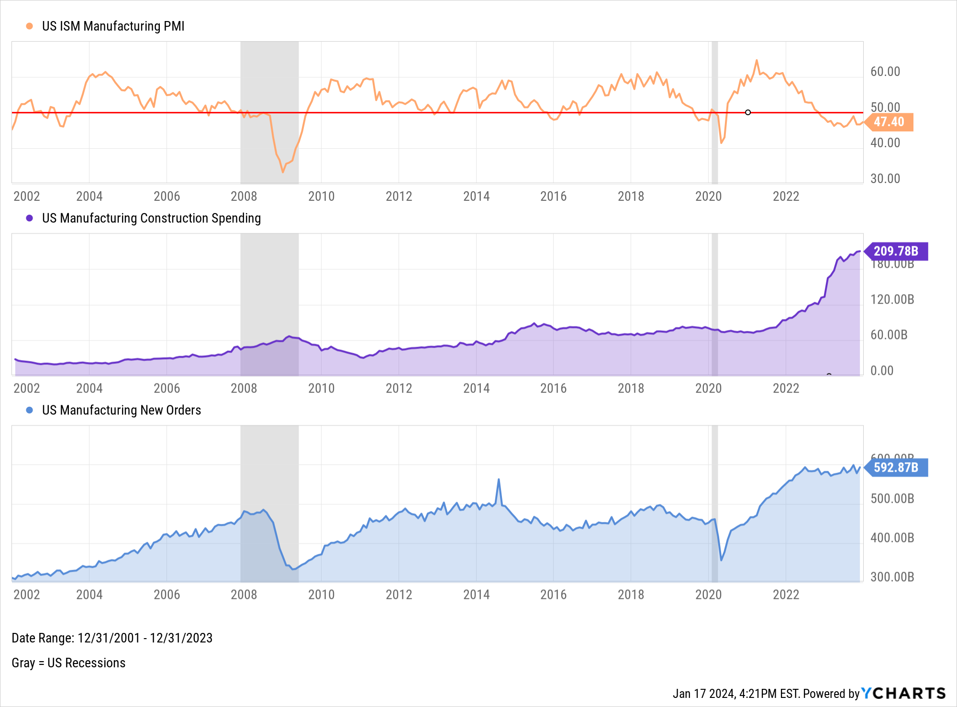
Manufacturing: Contraction, or Expansion?
Notes:
A reading below 50 indicates the US ISM Manufacturing PMI is in contraction territory. The Manufacturing PMI has been below 50 since November 2022. At the same time, US Manufacturing Construction Spending has accelerated since then, while the $ amount of US Manufacturing New Orders has remained at an elevated level.

Slide 32
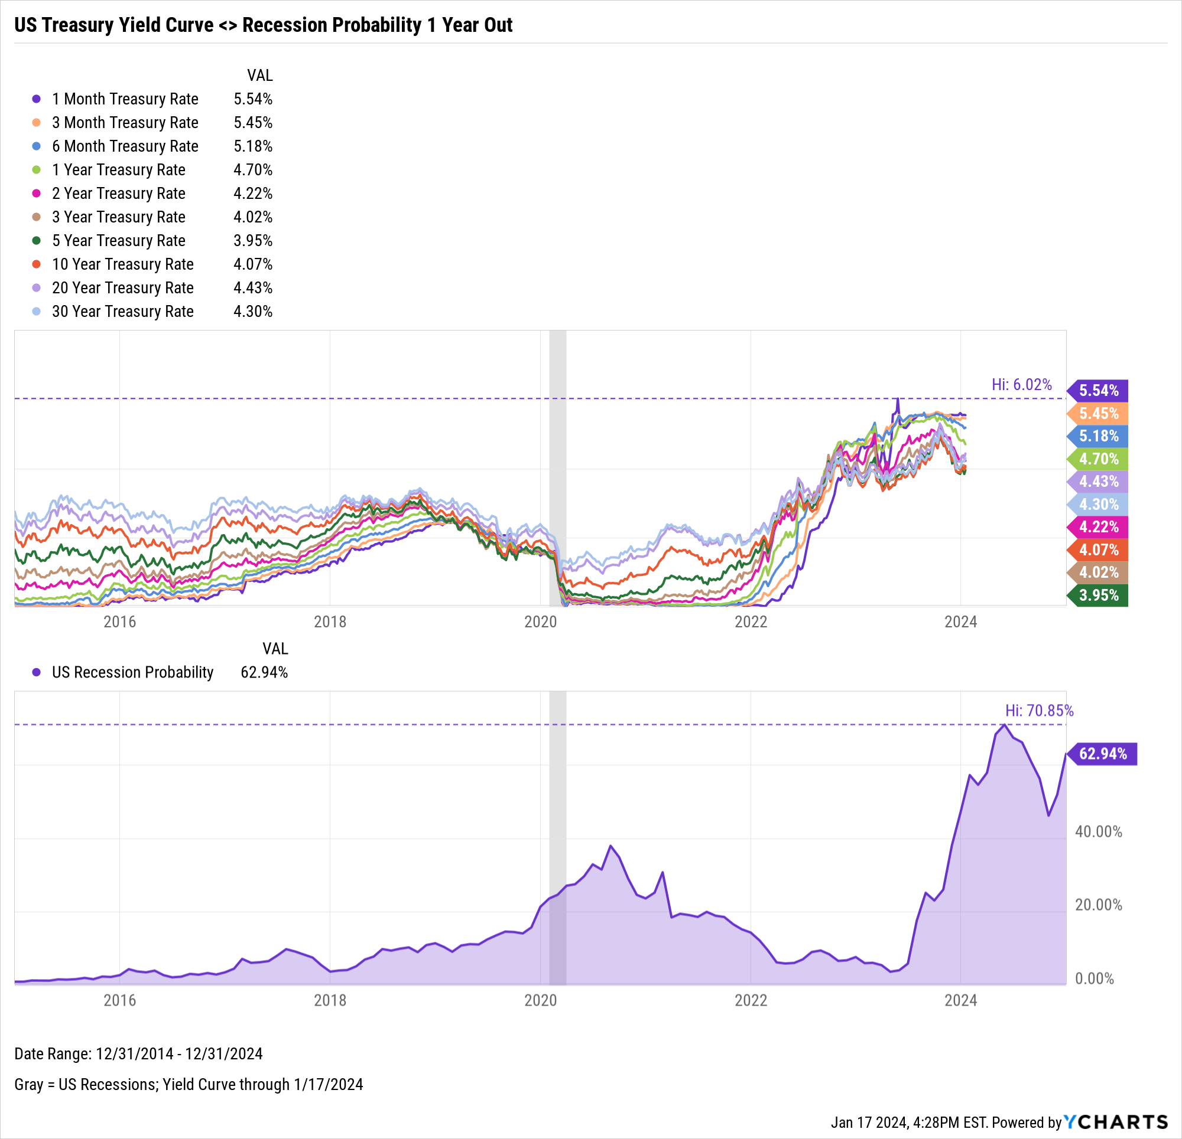
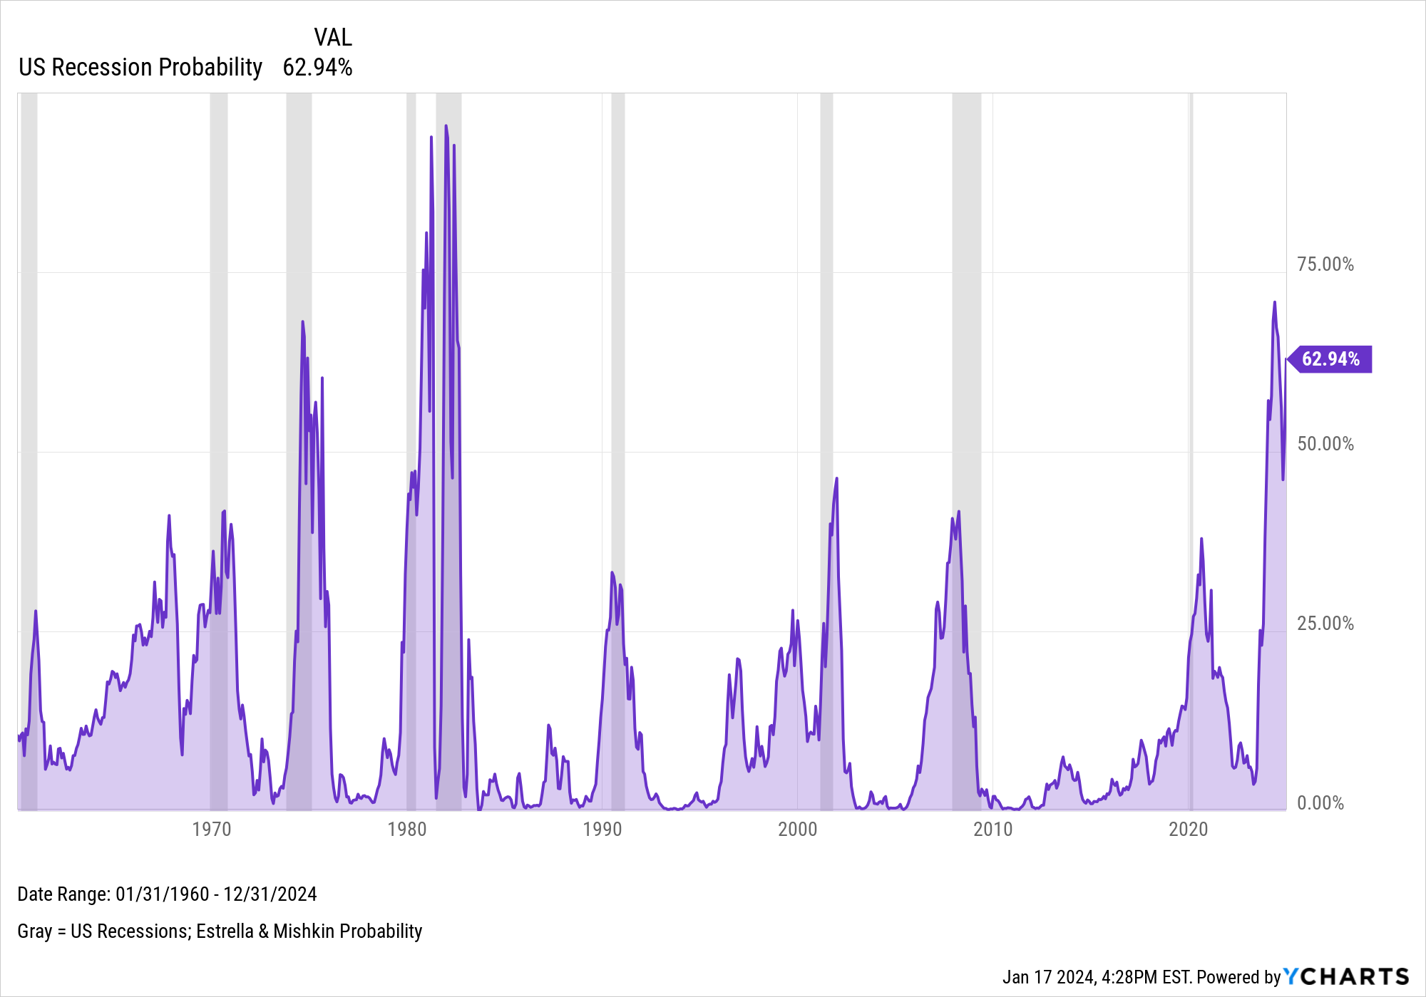
Yield Curve 🤝 Recession Probability
Notes:
The Yield Curve has been inverted for quite some time, causing the Estrella & Mishkin yield curve-based US Recession Probability indicator to spike. The current figure of 62.9% for December 31st, 2024 is higher than most recessions in recent memory, including the 1990s, dot-com bubble of 2001, GFC of 2008, and the brief pandemic recession in 2020.

